Slide 1
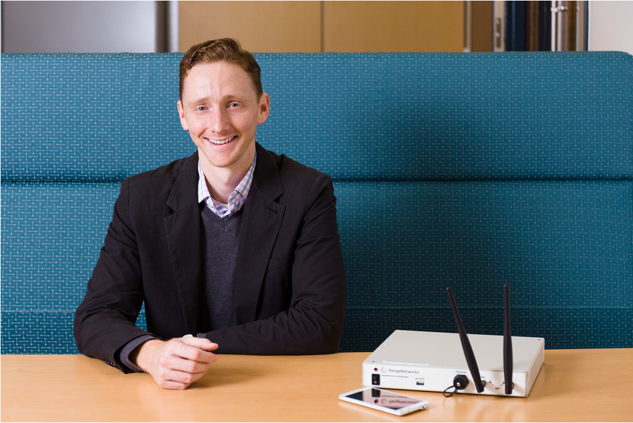
W ashington A rea T rustworthy C omputing H our
41st WATCH:
Security Challenges in the Landscape of
Emerging Digital Financial Services
Patrick Traynor
University of Florida
Thursday January 19, Noon, Room 110
Abstract
The developed world takes for granted the nearly universal deployment of cashless payment systems. From credit cards and online banking to massive scale business- to-business transactions, our modern economy is reliant on the regular and instantaneous movement of funds. Widespread access to this financial infrastructure is directly responsible for increased opportunity and prosperity. Unfortunately, only a small fraction of the developing world’s population has access to these systems.
Emerging digital financial services can bridge this gap. Such services enable financial inclusion through the nearly ubiquitous deployment of cellular networks and mobile devices around the world. Customers not only deposit their physical currency through a range of independent vendors, but can also perform direct peer-to-peer payments and convert credits from such transactions back into cash. An increasing number of these services now also offer credit to previously unserved populations. Over the past decade, these systems have helped to raise the standard of living and have revolutionized the way in which money is used in developing economies.
Unfortunately, our recently published analysis (Mo(bile) Money, Mo(bile) Problems: Analysis of Branchless Banking Applications in the Developing World, USENIX Security 2015) indicates that the information security practices in this space significantly lag behind those of traditional financial institutions. We have spent the past year working with policy makers, NGOs, academics, industry groups and individual companies; unfortunately, for all of the attention we have brought to the challenges facing this space, little has changed. As such, many of the world’s most financially vulnerable citizens remain at great risk of significant financial loss. This talk focuses on the technical and policy challenges we have encountered during our work, and discusses a number of possible ways forward.
Speaker
Patrick Traynor is the John and Mary Lou Dasburg Preeminent Chair in Engineering and an Associate Professor in the Department of Computer and Information Science and Engineering (CISE) at the University of Florida. His research focuses on the security of mobile systems, with a concentration on telecommunications infrastructure and mobile devices. His research has uncovered critical vulnerabilities in cellular networks, made the first characterization of mobile malware in provider networks and offers a robust approach to detecting and combatting Caller-ID scams. He is also interested in Internet security and the systems challenges of applied cryptography. He received a CAREER Award from the National Science Foundation in 2010, was named a Sloan Fellow in 2014 and a Fellow of the Center for Financial Inclusion at Accion in 2016.
Professor Traynor earned his Ph.D and M.S. in Computer Science and Engineering from the Pennsylvania State University in 2008 and 2004, respectively, and my B.S. in Computer Science from the University of Richmond in 2002. After promotion and tenure in the School of Computer Science at Georgia Tech, he joined the University of Florida in 2014 as part of the UFRising Preeminence Hiring Program. He is the co-director of the Florida Institute for Cybersecurity (FICS) and also a co-founder of CryptoDrop and Pindrop Security.
About the WATCH series:
Transforming today’s trusted but untrustworthy cyberinfrastructure into one that can meet society’s growing demands requires both technical advances and improved understanding of how people and organizations of many backgrounds perceive, decide to adopt, and actually use technology. WATCH aims to provide thought-provoking talks by innovative thinkers with ideas that illuminate these challenges and provide signposts toward solutions. The series is jointly organized by NSF’s Computer Science and Engineering (CISE) and Social, Behavioral, and Economic (SBE) Directorates and sponsored by the CISE Secure and Trustworthy Cyberspace (SaTC) Program. Talks will be recorded and made available over the Internet.
Thursday, Jan. 19, 2017
Questions/comments about WATCH?
Contact Nina Amla (namla@nsf.gov)
NSF Stafford I Room 110, Noon
Public Invited

