Slide 1
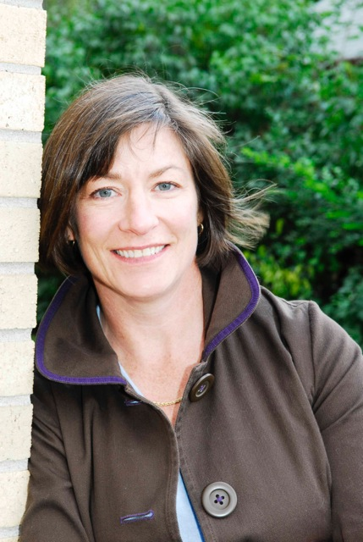
W ashington A rea T rustworthy C omputing H our
25th WATCH:
The burden of authentication: What friction points reveal
Dana Chisnell
Center for Civic Design
THURSDAY Nov.13th, Noon, Room 110
About the WATCH series:
Transforming today’s trusted but untrustworthy cyberinfrastructure into one that can meet society’s growing demands requires both technical advances and improved understanding of how people and organizations of many backgrounds perceive, decide to adopt, and actually use technology. WATCH aims to provide thought-provoking talks by innovative thinkers with ideas that illuminate these challenges and provide signposts toward solutions. The series is jointly organized by NSF’s Computer Science and Engineering (CISE) and Social, Behavioral, and Economic (SBE) Directorates and sponsored by the CISE Secure and Trustworthy Cyberspace (SaTC) Program. Talks will be recorded and made available over the Internet.
Abstract
Everyone whines about dealing with passwords and authentication, but what’s the real cost to individual users? In a study conducted with 23 people at the National Institute of Standards and Technology, we asked participants to tell us about every time they authenticated in a 24-hour period. From this, we learned that the friction of authentication goes beyond the specific act of authenticating, spilling over into tasks, productivity, and attitudes about compliance as people encountered the “wall of disruption” created by the enabling task of authentication.
Speaker
Dana's love of the usable and usability testing started when she participated in research on a mainframe office system developed by IBM. Since then Dana has worked with dozens of teams, gathering and analyzing user research data to inform product designs from software to websites to voting systems. She’s the co-director of the Center for Civic Design (civicdesign.org), where she conducts applied research and is the managing editor of the Field Guides To Ensuring Voter Intent. Dana recently concluded an NSF-funded study about the impact of poll worker behavior on election security. If you’re looking for guidance with user research, check out her book with Jeff Rubin, Handbook of Usability Testing Second Edition.
Thursday, Nov. 13, 2014
NSF Stafford I Room 110, Noon
Public Invited
Questions/comments about WATCH?
Contact Keith Marzullo kmarzull@nsf.gov

