Slide 1
Frontiers of Computing: A View from the National Science Foundation
Jeannette M. Wing
Assistant Director
Computer and Information Science and Engineering
National Science Foundation
and
President’s Professor of Computer Science
Carnegie Mellon University
Forum in Information and Communication Technology Research 2010 (ICTRF2010)
Abu Dhabi, UAE
9 May 2010
Notes:
1

Slide 2
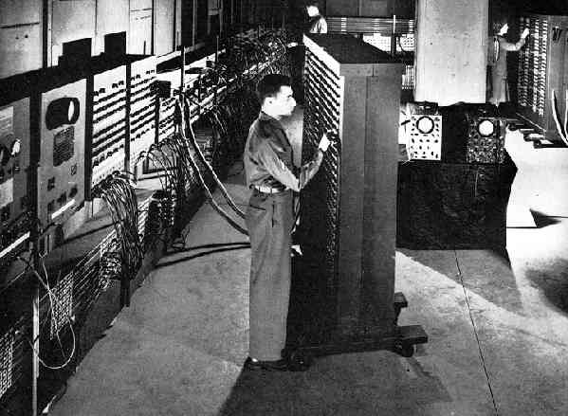

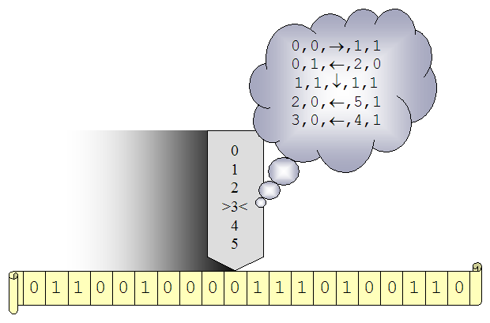
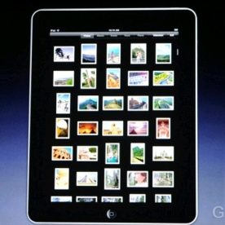

The Computing (R)Evolution
iPad
…
1935
1946
Credit: Apple, Inc.
2008
2010
Notes:
2
For the most part when we talk about computing we mean modern computing which started in 1935 with Alan Turing’s abstract notion of a machine (which you will more about later) and in 1936 with the Church-Turing Thesis that says anything that is computable can be computed by a Turing machine; modern computing became practical with the ENIAC, the first general-purpose Turing-complete electronic computer unveiled at the University of Pennsylvania in 1946, and of course with Shockley, Bardeen, and Brattain building the first transistor at Bell Labs in 1947. And so our field is very young. In fact, the oldest computer science departments in the world are only now celebrating their 50th birthdays.

Slide 3
Drivers of Computing
Society
Science
Technology
Notes:
Interlude: I have been recently arguing that the field of computing is driven by scientific questions, technology innovation, and societal demands. I make this argument for two reasons: first, for ourselves in the field of computing, we are often so swept up by our technological advances or societal expectations that we forget that there are some deep scientific questions that underlie our field. Second, for others outside of computing, it is important to explain that the weight of each, and moreover the combination of our three drivers—science, technology, and society—make our field unique, indeed distinctive from other sciences, mathematics, and engineering. Why not celebrate this distinction?
Moreover, as shown by the bidirectional arrows, there is wonderful interplay—push and pull—among these three drivers: In the usual loop, scientific discovery feeds technology innovation which feeds new societal applications; in the reverse direction, new technology inspires new creative societal uses, which may demand new scientific discovery.
Underlying all three kinds of drivers to our field of computing, there are fundamental, basic research questions to be answered.

Slide 4





































Economic Impact
Notes:
4
In just this short span of 40 or so years, computing has had tremendous impact on our economy through the creation of new industries: from telecommunications and networking companies, to computer companies, and to software companies. I think all of you will recognize at least a few of these company logos and I’m not even showing the broader impact computing has had on other industries as well.

Slide 5






























Social Impact
Various Company logos
Notes:
5
Computing has also had tremendous impact on society, affecting the way we lead our daily lives: the way we go shopping, find information, communicate with each other, do our taxes, manage our bank accounts, buy airline tickets, listen to music, watch movies, play games, and even find a date. The companies whose logos you see here are just examples of new industrial and economic sectors created because of the computing technology revolution.
What makes this all possible?

Slide 6
NSF

Slide 7
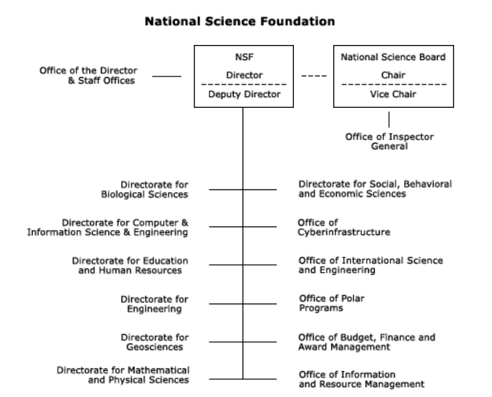

Slide 8
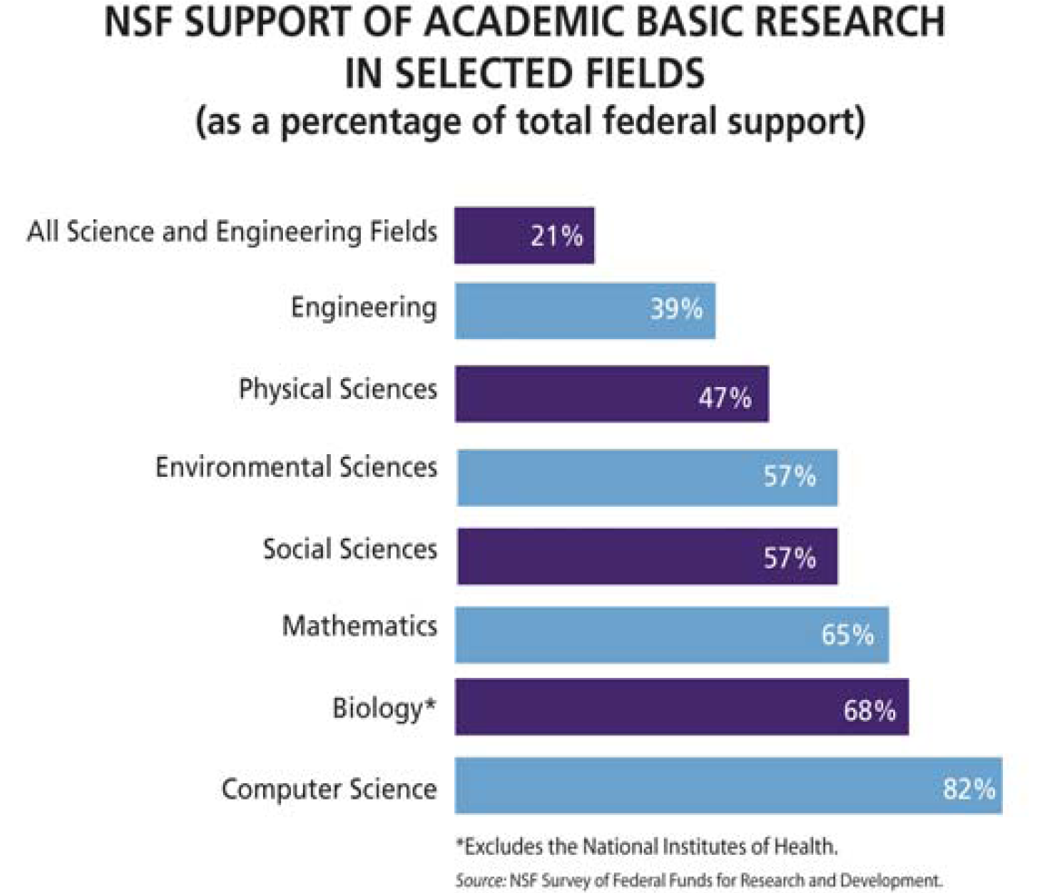

Slide 9
FY08-FY11 NSF/CISE Funding
FY08 NSF $6.13B
    CISE Appropriation was $535 million, 1.5% increase from FY07
FY09 NSF $6.49B, 7% over FY08
    CISE Appropriation was $574 million, 7.1% over FY08.
  ARRA (“stimulus”) NSF: $3 billion
    CISE ARRA: $235 million
FY10 NSF $6.93B, 7.07% over FY09
    CISE Appropriation is $618.83 million, 7.71% over FY09 (excl. ARRA).
FY11 NSF Request $7.4B, 8.5% over FY09
    CISE Request is $684.51 million, 10.6% over FY10

Slide 10
CISE-specific
NSF-wide Investments

Slide 11
CDI: Cyber-Enabled Discovery and Innovation
Paradigm shift
  Not just computing’s metal tools (transistors and wires) but also our mental tools (abstractions and methods)
It’s about partnerships and transformative research.
  To innovate in/innovatively use computational thinking; and
  To advance more than one science/engineering discipline.
Investments by all directorates and offices
  FY08: $48M, 1800 Letters of Intent, 1300 Preliminary Proposals, 200 Full Proposals, 36 Awards
  FY09: $63M+, 830 Preliminary Proposals, 283 Full Proposals, 53+ Awards
  FY10: 320 Full Proposals, … holding panels now ….
  FY11 President’s Request: > $100M
Computational Thinking for Science and Engineering
Notes:
~650 Data to Knowledge, 500 Understanding Complexity, < 200 Virtual Organizations
90 PDs (~35 from CISE) and 6 (4 from CISE) admin staff across the agency helped

Slide 12
Range of Disciplines in CDI Awards
Aerospace engineering
Astrophysics and cosmology
Atmospheric sciences
Biochemistry
Biomaterials
Biophysics
Chemical engineering
Civil engineering
Communications science and engineering
Computer science
Cosmology
Ecosystems
Genomics
Geosciences
Linguistics
Materials engineering
Mathematics
Mechanical engineering
Molecular biology
Nanocomputing
Neuroscience
Proteomics
Robotics
Social sciences
Statistics
Statistical physics
Sustainability
…
… advances via Computational Thinking

Slide 13
Science and Engineering Beyond Moore’s Law
Four directorates and offices: CISE, ENG, MPS, OCI
  All investing in core science, engineering, and technology
Multi-core, many-core, massively parallel
  Programming models, languages, tools
New, emerging substrates
  Nanocomputing
  Bio-inspired computing
  Quantum computing

Slide 14
CISE

Slide 15
Core and Cross-Cutting Programs
CCF
CNS
IIS
Core
Core
Core
Algorithmic F’ns
Communications &
Information F’ns
Software &
Hardware F’ns
Computer Systems
Network Systems
Infrastructure
Education & Workforce
Human-Centered
Information Integra-
tion & Informatics
Robust Intelligence
Cross-Cutting
Cyber-Physical Systems
Data-intensive Computing
Network Science and Engineering
Trustworthy Computing
Plus many many other programs with other NSF directorates and other agencies
Notes:
Small December up to $500,000
Medium October FY09 August FY10 $500,001 up to $1,200,000
Large December $1,200,000 up to $300,000,000

Slide 16
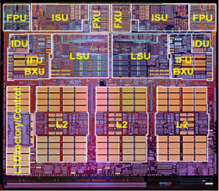
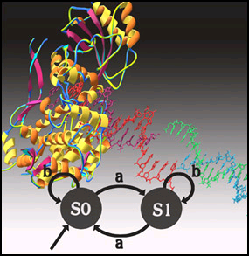
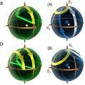
Computing and Communications Foundation (CCF)
Supports research and education activities that explore the foundations of computing and communication devices and their usage.
Seeks advances in algorithms for computer, computational sciences, and computing applications
Seeks advances in the architecture and design of software and hardware
Seeks advances in computing and communication theory
Investigates revolutionary computing models and technologies based on emerging scientific ideas
Multicore
Computing
BioComputing
QuantumComp
Moore’s Law Ending!... Emerging:
Credit: Oxford University

Slide 17
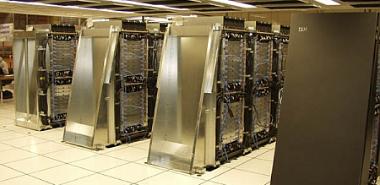
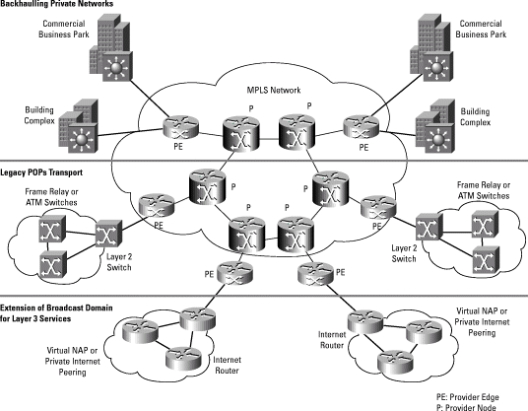
Computer and Network Systems Division (CNS)
Supports research and education activities that invent new computing and networking technologies and that explore new ways to make use of existing technologies.
Seeks to develop a better understanding of the fundamental properties of computer and network systems
Seeks to create better abstractions and tools for
designing, building, analyzing, and measuring future systems.
Supports the computing infrastructure that is
required for experimental computer science.

Slide 18
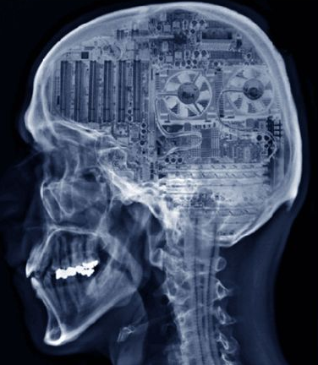
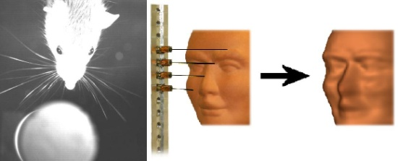
Information and Intelligent Systems Division (IIS)
Supports research and education activities that support the study of the inter-related roles of people, computers, and information
Seeks to develop new knowledge about the role of people in the design and use of information technology
Seeks to increase our capability to create, manage, and understand data and information in circumstances ranging from personal computers to globally-distributed systems
Seeks to advance our understanding of how computational systems can exhibit the hallmarks of intelligence.

Slide 19
Expeditions
Bold, creative, visionary, high-risk ideas
Whole >> Σ part _{i}
Solicitation is deliberately underconstrained
  Tell us what YOU want to do!
  Response to community
    Loss of ITR Large, DARPA changes, support for high-risk research, large experimental systems research, etc.
~ 3 awards, each at $10M for 5 year
  FY08 122 LOI, 75 prelim, 20 final, 7 reverse site visits, 4 awards
  FY09 48 prelim, 20 final, 7 reverse site visits, 3 awards
i
Notes:
$10M for five year ($2M/year)

Slide 20
FY08-FY09 Awards
FY08 Awards
  Computational Sustainability
    Gomes, Cornell, Bowdoin College, the Conservation Fund, Howard University, Oregon State University and the Pacific Northwest National Laboratory
  Intractability
    Arora, Princeton, Rutgers, NYU, Inst for Adv. Studies
  Molecular Programming
    Winfrey, Cal Tech, UW
  Open Programmable Mobile Internet
    McKeown, Stanford
FY09 Awards
  Customized Computing Technology
    Cong, UCLA
  Modeling Tools for Disease and Complex Systems
    Clarke, CMU, NYU, Cornell, SUNY Stony Brook, University of Maryland
  Robotic Bees
    Wood, Harvard

Slide 21
Cyber-Physical Systems

Slide 22
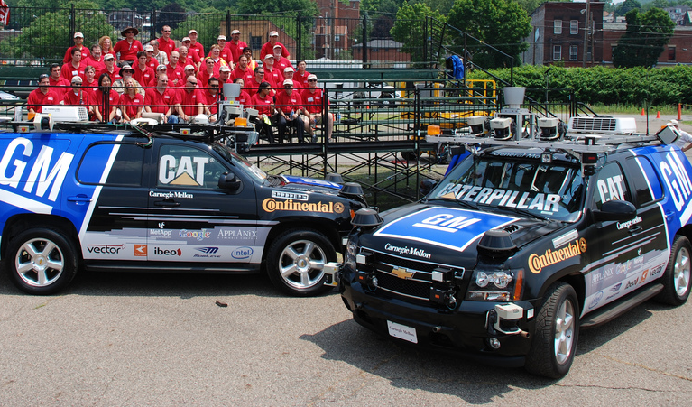

Smart Cars
A BMW is “now actually a network of computers”
  [R. Achatz, Seimens, Economist Oct 11, 2007]
Credit: PaulStamatiou.com
Cars drive themselves
Lampson’s Grand Challenge:
Reduce highway traffic deaths to zero.
  [Butler Lampson, Getting Computers to Understand, Microsoft, J. ACM 50, 1 (Jan. 2003), pp 70-72.]
Smart parking

Slide 23
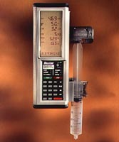
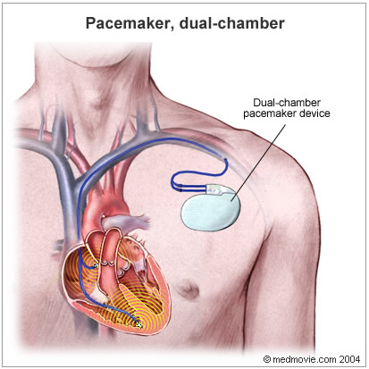
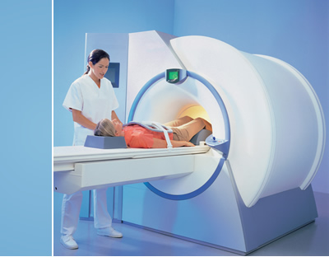
Embedded Medical Devices
Credit: Baxter International
infusion pump
pacemaker
scanner
Credit: Siemens AG
IBM Research
23
Jeannette M. Wing

Slide 24
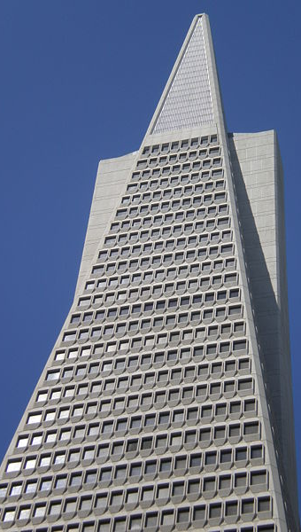
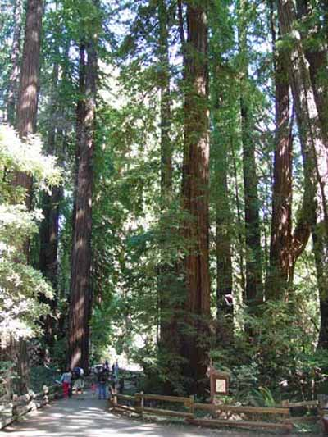
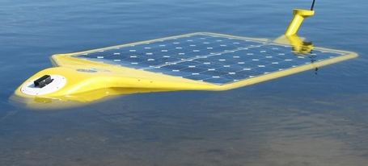
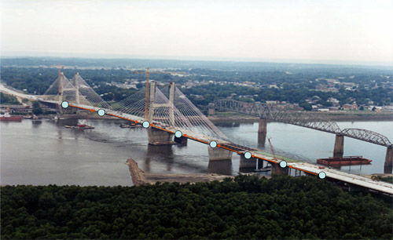
Sensors Everywhere
Credit: Arthur Sanderson at RPI
Hudson River Valley
Credit: MO Dept. of Transportation
Sonoma Redwood Forest
smart buildings
IBM Research
24
Jeannette M. Wing
smart bridges

Slide 25
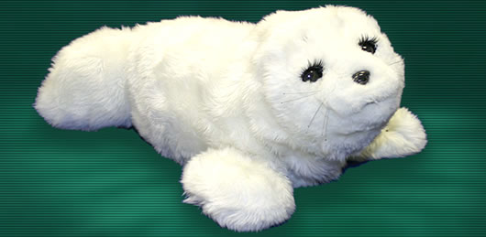
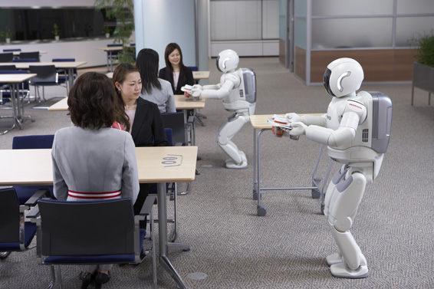
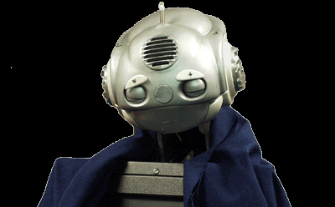
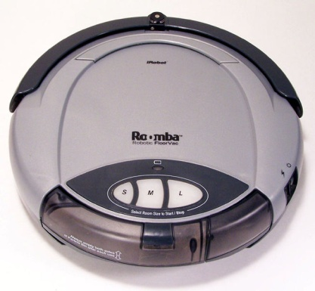
Robots Everywhere
Credit: Paro Robots U.S., Inc.
At home: Paro, therapeutic robotic seal
Credit: Carnegie Mellon University
Credit: Honda
At home/clinics: Nursebot, robotic assistance for the elderly
At work: Two ASIMOs working together in coordination to deliver refreshments
At home: iRobot Roomba vacuums your house

Slide 26
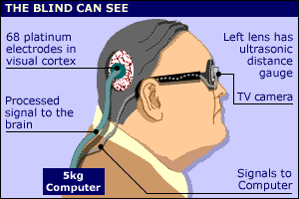
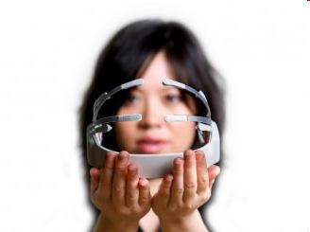

Assistive Technologies for Everyone
brain-computer interfaces of today
Credit: Dobelle Institute
memex of tomorrow
Credit: Emotiv
IBM Research
26
Jeannette M. Wing
Credit: Paramount Pictures

Slide 27
What is Common to These Systems?
They have a computational core that interacts with the physical world.
Cyber-physical systems are engineered systems that require tight conjoining of and coordination between the computational (discrete) and the physical (continuous).
Trends for the future
  Cyber-physical systems will be smarter and smarter.
  More and more intelligence will be in software.

Slide 28
A (Flower) Model for Expediting Progress
Sectors
Industry
Gov’t (e.g., military)
medical
aero
finance
Industry
Gov’t
Academia
Fundamental
Research
auto
transportation
Academia
Gov’t (NSF, NSA,
NIH, DoD, …)
energy
civil
chemical
materials

Slide 29
Data-Intensive Computing

Slide 30
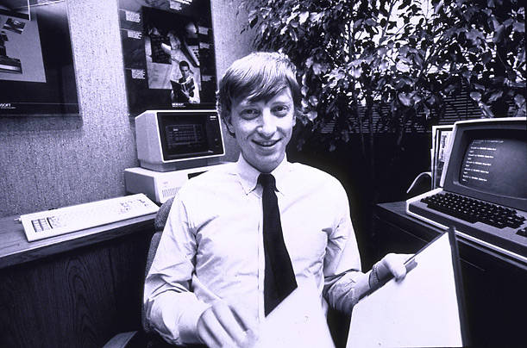
How Much Data?
NOAA has ~1 PB climate data (2007)
Wayback machine has ~2 PB (2006)
HP is building WalMart a 4PB data warehouse (2007)
CERN’s LHC will generate 15 PB a year (2008)
Google processes 20 PB a day (2008)
Square Kilometer Array will generate 1 EB/week
Commercial DNA sequencers generate 1 TB/minute
“all words ever spoken by human beings” ~ 5 EB
Int’l Data Corp predicts 1.8 ZB of digital data by 2011
640K ought to be enough for anybody.
Slide source: Jimmy Lin, UMD

Slide 31
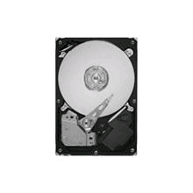
Convergence in Trends
Drowning in data
Data-driven approach in computer science research
  graphics, animation, language translation, search, …, computational biology
Cheap storage
  Seagate Barracuda 1TB hard drive for $79
Growth in huge data centers
Data is in the “cloud” not on your machine
Easier access and programmability by anyone
  e.g., Amazon EC2, Hadoop/MapReduce, Open Cloud Consortium, Windows Azure

Slide 32
Cloud Computing
Sample Research Questions
Science
  What are the fundamental capabilities and limitations of this paradigm?
  What new programming abstractions (including models, languages, algorithms) can accentuate these fundamental capabilities?
  What are meaningful metrics of performance and QoS?
Engineering
  How can we automatically manage the hardware and software of these systems at scale?
  How can we provide security and privacy for simultaneous mutually untrusted users, for both processing and data?
  How can we reduce these systems’ power consumption?
Users
  What (new) applications can best exploit this computing paradigm?
  How can Big Data Science exploit this computing paradigm?

Slide 33
Data-Intensive Computing Infrastructure for CISE Community
Google + IBM partnership announced in February 2008
  Access to 1600+ nodes, software and services (Hadoop, Tivoli, etc.)
  Cluster Exploratory (CluE) seed program
  April 23, 2008: Press release on CluE awards to 14 universities
    http://www.nsf.gov/news/news_summ.jsp?cntn_id=114686&org=NSF&from=news
  Oct 5-6, 2009: CluE PI meeting, Mountain View, CA
    https://wiki.umiacs.umd.edu/ccc/index.php/CLuE_PI_Meeting_2009
HP + Intel + Yahoo! + UIUC cluster announced in July 2008
  1000+ nodes
  Bare machine, not just software (Hadoop) accessible
  Hosted at UIUC, available to entire community
Microsoft partnership to provide Windows Azure platform
  Announced February 4, 2010
  Supplements, EAGERs, Cloud in Computing solicitation
  Engages BIO, EHR, GEO, MPS, OCI, SBE too.
CISE Overview
33
Jeannette M. Wing

Slide 34
Network Science and Engineering

Slide 35



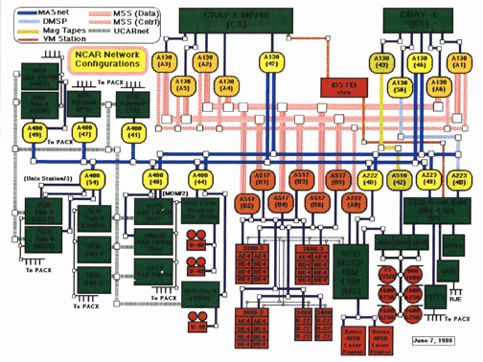




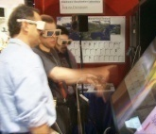


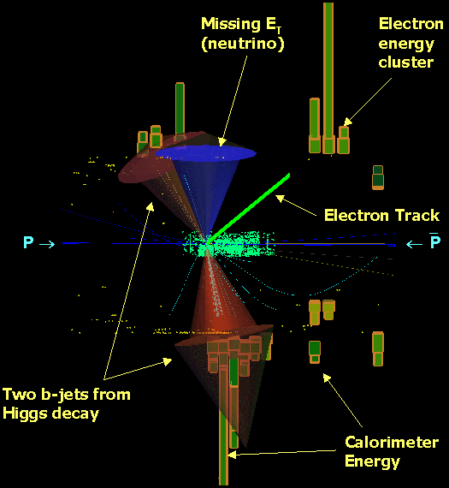

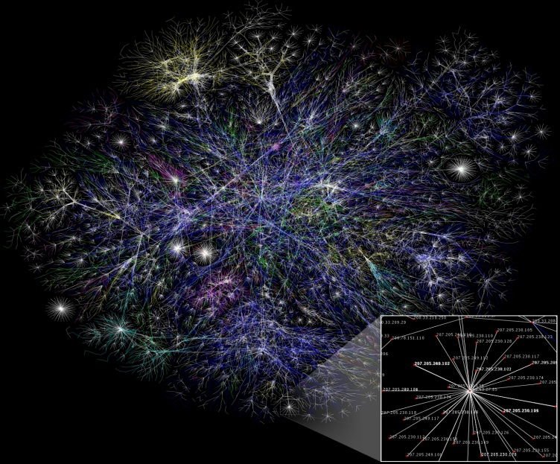



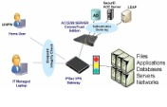
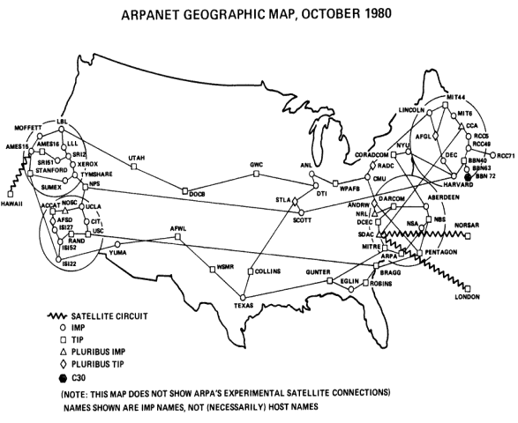

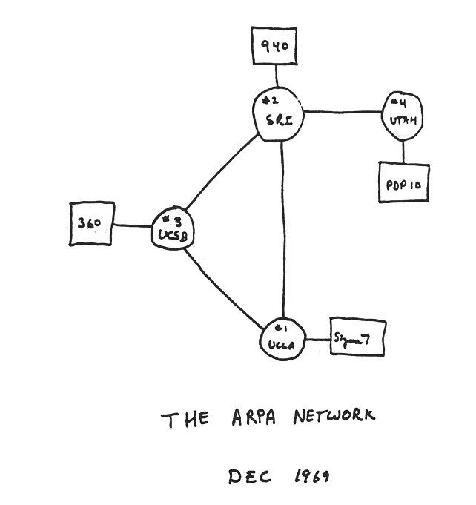


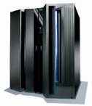



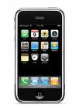

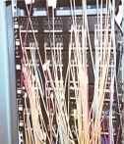
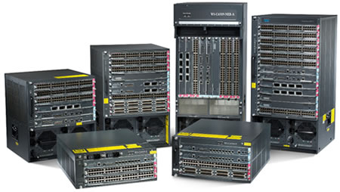

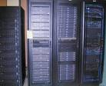

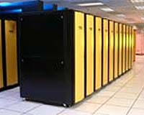
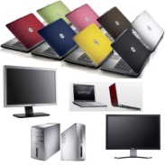
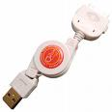
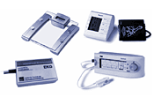
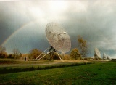
Our Evolving Networks are Complex
1970
1980
1999
Notes:
The networks that we have created and that have evolved over the decades are complex.
For example, the Internet is complex. Here is a picture of the ARPANET in 1970. Here it is in 1980. Twenty years later, it is too complex to draw, let alone understand, model, or predict its behavior. The Internet is computer science’s gift to society, but ironically we cannot even describe it.
We interpret networks at multiple layers of abstraction. Below, we are concerned with new technologies: in the beginning we communicated via phone lines, modems, and cables underground and now we have a proliferation of communication media and a proliferation of devices, sensors, and actuators.
Above, we are concerned with new kinds of social uses of our computers and networks: from the days when people shared a terminal, to today where we have a multitude of applications, from the good to the bad. Examples of the good are on-line banking, social networks, and open courseware that already enables tens of millions of people, including tens of thousands of high school students, to learn from famous professors. Examples of the bad are spam, worms and viruses, and distributed denial of service.
I’ve shown pictures of the past and the present. What about the future? I believe that if we understand the complexity of our networks better then we can evolve them in ways that can unleash unimaginable creativity and innovation—from new technologies, to new applications, to new users—and hopefully at the same time improve the overall security of our networked systems.
35

Slide 36


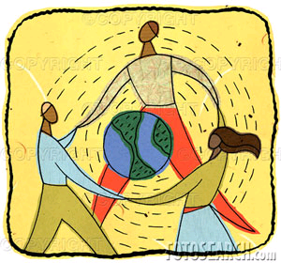
Our Evolving Networks are Complex
1970
1980
1999
Notes:
The networks that we have created and that have evolved over the decades are complex.
For example, the Internet is complex. Here is a picture of the ARPANET in 1970. Here it is in 1980. Twenty years later, it is too complex to draw, let alone understand, model, or predict its behavior. The Internet is computer science’s gift to society, but ironically we cannot even describe it.
We interpret networks at multiple layers of abstraction. Below, we are concerned with new technologies: in the beginning we communicated via phone lines, modems, and cables underground and now we have a proliferation of communication media and a proliferation of devices, sensors, and actuators.
Above, we are concerned with new kinds of social uses of our computers and networks: from the days when people shared a terminal, to today where we have a multitude of applications, from the good to the bad. Examples of the good are on-line banking, social networks, and open courseware that already enables tens of millions of people, including tens of thousands of high school students, to learn from famous professors. Examples of the bad are spam, worms and viruses, and distributed denial of service.
I’ve shown pictures of the past and the present. What about the future? I believe that if we understand the complexity of our networks better then we can evolve them in ways that can unleash unimaginable creativity and innovation—from new technologies, to new applications, to new users—and hopefully at the same time improve the overall security of our networked systems.
36

Slide 37

Our Evolving Networks are Complex
1970
1980
1999
Notes:
The networks that we have created and that have evolved over the decades are complex.
For example, the Internet is complex. Here is a picture of the ARPANET in 1970. Here it is in 1980. Twenty years later, it is too complex to draw, let alone understand, model, or predict its behavior. The Internet is computer science’s gift to society, but ironically we cannot even describe it.
We interpret networks at multiple layers of abstraction. Below, we are concerned with new technologies: in the beginning we communicated via phone lines, modems, and cables underground and now we have a proliferation of communication media and a proliferation of devices, sensors, and actuators.
Above, we are concerned with new kinds of social uses of our computers and networks: from the days when people shared a terminal, to today where we have a multitude of applications, from the good to the bad. Examples of the good are on-line banking, social networks, and open courseware that already enables tens of millions of people, including tens of thousands of high school students, to learn from famous professors. Examples of the bad are spam, worms and viruses, and distributed denial of service.
I’ve shown pictures of the past and the present. What about the future? I believe that if we understand the complexity of our networks better then we can evolve them in ways that can unleash unimaginable creativity and innovation—from new technologies, to new applications, to new users—and hopefully at the same time improve the overall security of our networked systems.
37

Slide 38

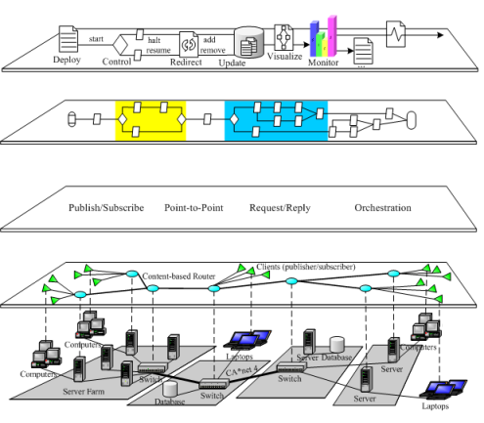
Challenge to the Community
Fundamental Question: Is there a science for understanding the complexity of our networks such that we can engineer them to have predictable (or adaptable) behavior?
Credit Middleware Systems Research Group
Notes:
Motivated by these observations, herein lies a fundamental question:
Is there a science for understanding the complexity of our networks such that we can engineer them to have predictable behavior?
I interpret the term “networks” broadly. We need to understand networks at multiple layers of abstraction, as illustrated by the picture: from the physical layer on the bottom through multiple architectural and protocol layers in the middle all the way up to the top layer of networks of people, organizations, and societies.

Slide 39
Network Science and Engineering: Fundamental Challenges
Understand the complexity of large-scale networks
Network science, comm’ns and
information theory researchers
Science
- Understand emergent behaviors, local–global interactions, system failures and/or degradations
- Develop models that accurately predict and control network behaviors
Technology
Develop new architectures, exploiting new substrates
Networking, distributed systems, optical, and wireless, researchers
- Develop architectures for self-evolving, robust, manageable future networks
- Develop design principles for seamless mobility support
- Leverage optical and wireless substrates for reliability and performance
- Understand the fundamental potential and limitations of technology
Enable new applications and new economies, while ensuring security and privacy
Society
Security, privacy, economics, AI, social science researchers
- Design secure, survivable, persistent systems, especially when under attack
- Understand technical, economic and legal design trade-offs, enable privacy protection
- Explore AI-inspired and game-theoretic paradigms for resource and performance optimization
Notes:
The field of computing has science drivers, technology drivers, and societal drivers. Network science and engineering is no different. For all three drivers, there are fundamental challenges that face us if we are to make progress in answering the question stated earlier. Let’s use these three interacting sets of drivers to frame a research agenda for network science and engineering. I’ll start with the science drivers.
The scientific challenge is to understand the complexity of networked systems. We do not have theories of our networks such that we understand their emergent properties. We do not have formal models of our networks such that we can assert any guarantees of reliability or survivability, especially in the presence of disruptive events or malicious attacks. We do not have models of our networks such that we can accurately predict their performance; for example Poisson models and heavy-tail distribution models are unrealistic or overly simplistic.
The technology drivers come from new communication substrates such as wireless and optical. These new substrates change the physical characteristics of the network, suggesting new network architectures, where the goal is not just simply optimizing the transmission of a packet from one host to another. For example, because of increased bandwidth and large distances between nodes we already view the network not just as a communication medium but as a storage medium. Technology drivers also come from new devices. The ubiquity of mobile computing and communication devices, for example, is forcing us to rethink our networks in truly fundamental ways, to include at the very least the human dimension of what networks are.
Moreover, new theories and new architectures enable new societal uses of the network—creating new opportunities such as virtual worlds and new challenges such as ensuring the security and privacy of users and their data.
For your interest, I’ve included in small font, a sampling of fundamental challenges for each of these three drivers.
The research communities active in addressing these intellectual challenges are correspondingly listed on the right. Indeed one of the opportunities in developing a research agenda for network science and engineering, is ambitiously to ignite a diverse range of communities to work together and look at networked systems from a holistic viewpoint—it’s not enough to invent a new theory, a new architecture, or a new application without understanding the implications it has for all aspects of the networked system.
I would like to emphasize the expanse of these intellectual challenges. I am talking not just about networks as the invisible infrastructure that we all take for granted today, but about networks of people and organizations that creatively use the invisible infrastructure in unforeseen ways.
To calibrate the rapid growth in societal impact of the Internet, let me give you some concrete examples: Mosaic, the first browser, was created in 1993 and Google was founded in 1998, less than ten years ago. Google is known for search but it makes its money on ads; who would have guessed? (As as aside: remember that Mosaic and Google, like other browsers and search engines, were born out of NSF/CISE-funded research projects in universities.) Within just the past four years, we have seen the creation and influence of social networks embraced by the younger generation: SecondLife, FaceBook, and YouTube. We are also seeing old institutions remake themselves, including the print media like newspapers and the music recording industry. More sobering, in April of this year we witnessed the first cyber attack on a nation—Estonia—by a well-organized group in Russia. And just three weeks ago, the US company Seagate reported that hard drives sold in Taiwan contained Trojan Horses planted by subcontractors in China so that any information stored on those tainted hard drives was automatically uploaded to websites in Beijing. We did not anticipate any of these phenomena—good and bad—nor did we anticipate how they have completely changed the way in which people and organizations interact with each other.
It is the expanse of all these intellectual challenges that necessitates including not just researchers in computer and information science and engineering, but researchers in economics and the social sciences.

Slide 40
Network Science and Engineering: Fundamental Challenges
Understand the complexity of large-scale networks
Network science, comm’ns and
information theory researchers
Science
- Understand emergent behaviors, local–global interactions, system failures and/or degradations
- Develop models that accurately predict and control network behaviors
Technology
Develop new architectures, exploiting new substrates
Networking, distributed systems, optical, and wireless, researchers
- Develop architectures for self-evolving, robust, manageable future networks
- Develop design principles for seamless mobility support
- Leverage optical and wireless substrates for reliability and performance
- Understand the fundamental potential and limitations of technology
Enable new applications and new economies, while ensuring security and privacy
Society
Security, privacy, economics, AI, social science researchers
- Design secure, survivable, persistent systems, especially when under attack
- Understand technical, economic and legal design trade-offs, enable privacy protection
- Explore AI-inspired and game-theoretic paradigms for resource and performance optimization
Notes:
The field of computing has science drivers, technology drivers, and societal drivers. Network science and engineering is no different. For all three drivers, there are fundamental challenges that face us if we are to make progress in answering the question stated earlier. Let’s use these three interacting sets of drivers to frame a research agenda for network science and engineering. I’ll start with the science drivers.
The scientific challenge is to understand the complexity of networked systems. We do not have theories of our networks such that we understand their emergent properties. We do not have formal models of our networks such that we can assert any guarantees of reliability or survivability, especially in the presence of disruptive events or malicious attacks. We do not have models of our networks such that we can accurately predict their performance; for example Poisson models and heavy-tail distribution models are unrealistic or overly simplistic.
The technology drivers come from new communication substrates such as wireless and optical. These new substrates change the physical characteristics of the network, suggesting new network architectures, where the goal is not just simply optimizing the transmission of a packet from one host to another. For example, because of increased bandwidth and large distances between nodes we already view the network not just as a communication medium but as a storage medium. Technology drivers also come from new devices. The ubiquity of mobile computing and communication devices, for example, is forcing us to rethink our networks in truly fundamental ways, to include at the very least the human dimension of what networks are.
Moreover, new theories and new architectures enable new societal uses of the network—creating new opportunities such as virtual worlds and new challenges such as ensuring the security and privacy of users and their data.
For your interest, I’ve included in small font, a sampling of fundamental challenges for each of these three drivers.
The research communities active in addressing these intellectual challenges are correspondingly listed on the right. Indeed one of the opportunities in developing a research agenda for network science and engineering, is ambitiously to ignite a diverse range of communities to work together and look at networked systems from a holistic viewpoint—it’s not enough to invent a new theory, a new architecture, or a new application without understanding the implications it has for all aspects of the networked system.
I would like to emphasize the expanse of these intellectual challenges. I am talking not just about networks as the invisible infrastructure that we all take for granted today, but about networks of people and organizations that creatively use the invisible infrastructure in unforeseen ways.
To calibrate the rapid growth in societal impact of the Internet, let me give you some concrete examples: Mosaic, the first browser, was created in 1993 and Google was founded in 1998, less than ten years ago. Google is known for search but it makes its money on ads; who would have guessed? (As as aside: remember that Mosaic and Google, like other browsers and search engines, were born out of NSF/CISE-funded research projects in universities.) Within just the past four years, we have seen the creation and influence of social networks embraced by the younger generation: SecondLife, FaceBook, and YouTube. We are also seeing old institutions remake themselves, including the print media like newspapers and the music recording industry. More sobering, in April of this year we witnessed the first cyber attack on a nation—Estonia—by a well-organized group in Russia. And just three weeks ago, the US company Seagate reported that hard drives sold in Taiwan contained Trojan Horses planted by subcontractors in China so that any information stored on those tainted hard drives was automatically uploaded to websites in Beijing. We did not anticipate any of these phenomena—good and bad—nor did we anticipate how they have completely changed the way in which people and organizations interact with each other.
It is the expanse of all these intellectual challenges that necessitates including not just researchers in computer and information science and engineering, but researchers in economics and the social sciences.

Slide 41
Trustworthy Computing

Slide 42
Broader Context: Trustworthy Systems
Trustworthy =
  Reliability
    Does it do the right thing?
  Security
    How vulnerable is it to attack?
  Privacy
    Does it protect a person’s information?
  Usability
    Can a human use it easily?

Slide 43
Technical Progress: Reliability
Formal definitions, theories, models, logics, languages, algorithms, etc. for stating and proving notions of correctness.
Tools for analyzing systems—from code to architecture—for desired and undesired properties
Use of languages, tools, etc. in industry.
  “Reliable” [= “good enough”] systems in practice: telephony, the Internet, desktop software, your automobile
Examples:
  Strongly typed programming languages rule out entire classes of errors.
  Database systems are built to satisfy ACID properties: atomicity, consistency, isolation, durability
  Byzantine fault-tolerance, n > 3t+1
  Impossibility results, e.g., distributed consensus with 1 faulty node
Current challenge: Nature and scale of systems and their operating environments are more complex, forcing us to revisit these fundamental results. E.g., cyber-physical systems, safety-critical systems.

Slide 44
Technical Progress: Security
Formal definitions, theories, models, logics, languages, algorithms, etc. for stating and proving notions of security.
Tools for analyzing systems—from code to architecture—desired and undesired properties
Use of languages, tools, etc. in industry.
  Secure [= “secure enough”] systems in practice: telephony, the Internet, desktop software, your automobile (today)
Examples:
  Cryptography
  Systems designed to satisfy informally CIA properties (confidentiality, integrity, availability).
  Logic of authentication [BurrowsAbadiNeedham89], logic for access control [LampsonAbadiBurrowsWobber92]
Current challenges: (1) Assumptions have changed; revisit the blue. (2) Fill in the gray. (3) Nature and scale of systems and their operating environments are more complex, forcing us to revisit the fundamentals. E.g., today’s crypto rests (mostly) on RSA, i.e., hardness of factoring.

Slide 45
Big Picture: It’s not just security
Trustworthy systems
  Reliability
  Security
  Privacy
  Usability
people
service
application
system arch.
program
prog. lang.
Holistic view
−Technical: The whole stack
compiler
O/S
    − Non-Technical
    Psychology and human behavior
      - Usable security - Social engineering attacks - Privacy
      - Insider threat - Attacker’s motivation
    Economics, risk management, law, politics
hardware

Slide 46
Others
Joint with other directorates and offices
  CISE + BIO + SBE + MPS: Computational Neuroscience (with NIH)
  CISE + ENG: Cyber-Physical Systems, Multi-core (with SRC)
  CISE + MPS: FODAVA (with DHS), MCS
  OCI + OCI: HECURA, DataNet, SI²
Activities with other agencies, e.g., DARPA, DHS, IARPA, NGA, NIH, NSA, ONC
Partnerships with companies
  Google+IBM, HP+Intel+Yahoo!, Microsoft: Data-Intensive Computing
  SRC: Multi-core
Activities with other countries: Germany (CRCNS), China (3rd summit in June)
Research infrastructure: CRI, MRI
…
Please see website www.cise.nsf.gov for full list.

Slide 47
New for FY10

Slide 48



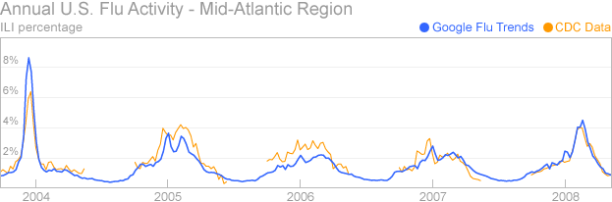




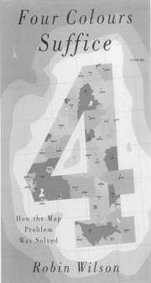
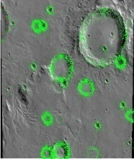















Clickworkers
Collaborative Filtering
Collaborative Intelligence
Collective Intelligence
Computer Assisted Proof
Crowdsourcing
eSociety
Genius in the Crowd
Human-Based Computation
Participatory Journalism
Pro-Am Collaboration
Recommender Systems
Reputation Systems
Social Commerce
Social Computing
Social Technology
Swarm Intelligence
Wikinomics
Wisdom of the Crowds

Slide 49
Clickworkers
Collaborative Filtering
Collaborative Intelligence
Collective Intelligence
Computer Assisted Proof
Crowdsourcing
eSociety
Genius in the Crowd
Human-Based Computation
Participatory Journalism
Pro-Am Collaboration
Recommender Systems
Reputation Systems
Social Commerce
Social Computing
Social Technology
Swarm Intelligence
Wikinomics
Wisdom of the Crowds
Socially Intelligent Computing
DAC
49
Jeannette M. Wing

Slide 50
Sample Research Questions
Science
  Can we understand the capabilities of humans and computers working in harmony, solving problems neither can solve alone?
  Can we characterize the emergent behavior of socially intelligent systems?
Technology/Engineering
  How can we design socially intelligent systems with a particular goal or particular desired properties in mind?
  How do we evaluate, e.g., measure the effectiveness, of socially intelligent systems?
Society/Users/Applications
  What grander outcomes can be envisioned when the collectives and crowds are computationally mediated, for example, moving beyond voting to collaborative governance?

Slide 51
Socially Intelligent Computing:
Computing BY and FOR Society
FY09 Social-Computational Systems (SoCS) (pronounced “socks”)
  CISE + SBE, $15M, deadline Sept. 21, 2009
  Received 148 Proposals composing 120 Projects
  http://www.nsf.gov/funding/pgm_summ.jsp?pims_id=503406&org=CISE&from=home
Three Common Themes to SoCS
  Computers as participants
    Let people do what people do best, let computers do what computers do best
  Better understanding of people
    How we interact with one another and with computers at wide ranges of granularity
  New forms of intelligence
    Computational parts of these systems need to exhibit social and perceptual sophistication

Slide 52



Computer Science and Economics
Computer Science influencing Economics
Economics influencing Computer Science
Automated mechanism design underlies electronic commerce,
e.g., ad placement, on-line auctions, kidney exchange
Internet marketplace requires revisiting Nash equilibria model
Use intractability for voting schemes to circumvent impossibility results
Research Issues at the Interface of Computer Science and Economics Workshop
- Ithaca, September 3-4, 2009, sponsored by CISE
- Stellar line up of computer scientists and economists
- http://www.cis.cornell.edu/conferences_workshops/CSECON_09/

Slide 53
Education and Workforce

Slide 54
Education Implications for K-12
Question and Challenge for the Computing Community:
What is an effective way of learning (teaching) computational thinking by (to) K-12?
- What concepts can students (educators) best learn (teach) when?
What is our analogy to numbers in K, algebra in 7, and calculus in 12?
- We uniquely also should ask how best to integrate The Computer
with teaching the concepts.
Two CSTB Workshops on Computational Thinking for Everyone.
First workshop report: http://www.nap.edu/catalog.php?record_id=12840

Slide 55
C.T. in Education: Community Efforts
FY09 Highlights
College Board: AP
10,000 x 10,000
“C” in STEM
ACM-Ed
Computing
Community
CRA-E
CSTA
NSF
College Board
Rebooting
Computational
Thinking
National Academies
workshops
CSTB “CT for Everyone” Steering Committee
Marcia Linn, Berkeley
Al Aho, Columbia
Brian Blake, Georgetown
Bob Constable, Cornell
Yasmin Kafai, U Penn
Janet Kolodner, Georgia Tech
Larry Snyder, U Washington
Uri Wilensky, Northwestern
K-12
BPC
CPATH
AP

Slide 56

Adding “C” to STEM
STEM = Science, Technology, Engineering, and Mathematics
Time is right.
  Society needs more STEM-capable students and teachers.
  The Administration understands the importance of STEM.
Hill Event to promote this vision
  Wed, May 29, 2009 12:00 - 1:30 PM B339 Rayburn House Office Building
Computer Science Education Week
  December 5-11, 2009
  Designation by US House of Representatives

Slide 57
Looking Ahead to FY11 and Beyond in Computing

Slide 58
IT and Sustainability (Energy, Environment, Climate)
IT as part of the problem and IT as part of the solution
IT as a consumer of energy
  2% (and growing) of world-wide energy use due to IT
IT as a helper, especially for the other 98%
  Direct: reduce energy use, recycle, repurpose, …
  Indirect: e-commerce, e-collaboration, telework -> reduction travel, …
  Systemic: computational models of climate, species, … -> inform science and inform policy
Engages the entire CISE community
  Modeling, simulation, algorithms
  Energy-aware computing
  Science of power management
  Sensors and sensor nets
  Intelligent decision-making
  Energy: A new measure of algorithmic complexity and system performance, along with time and space
CISE’s part of NSF’s FY10 Climate Research Initiative (CRI)
and NSF’s FY Science, Engineering, and Education for Sustainability (SEES)
Notes:
Organization of Economic Co-Operation and Development (OECD)

Slide 59
CyberLearning
NSF Task Force on Innovation and Learning
  - Chaired by Jeannette Wing, members from CISE, EHR, GEO, OCI, SBE
  - Informing NSF’s interests in CyberLearning
  - Coordinating with NSB’s interest in a STEM-literate workforce
  - Administration interest in K-12 STEM education
FY11 Cyberlearning Transforming Education (CTE): CISE, EHR, SBE
CISE Overview
59
Jeannette M. Wing
Anytime, Anywhere Learning
Personalized Learning
(Cyber)Learning about (Cyber)Learning

Slide 60
Smart Health
It’s more than electronic health records
It’s more than digitizing current data and processes
What are the computing research challenges such that we can transform healthcare delivery and wellness management of all individuals?
Modeling, decision making, discovery, visualization, summarization, data availability, smart sensing, telemetry, actuation for patient monitoring, robotics and vision for diagnosis and surgery, deployment (software integration), security and privacy, …

Slide 61
Computer Science and Biology
Gene sequencing and bioinformatics are a given
Trend now is looking at common principles between the two disciplines
  Complex systems
    Uncertainty of environment
    Networked
    Real-time adaptation
    Fault-tolerant, resilient
  Information systems
  Programmed systems
    Synthetic biology
First decade of CS+Bio was low-hanging fruit.
Second decade will form deeper and closer connections.

Slide 62



Drivers of Computing
7A’s
Anytime Anywhere
Affordable
Access to Anything by Anyone Authorized.
Society
Science
Technology
What is computable?
P = NP?
(How) can we build complex
systems simply?
What is intelligence?
What is information?
J. Wing, “Five Deep Questions in Computing,” CACM January 2008

Slide 63



Drivers of Computing
7A’s
Anytime Anywhere
Affordable
Access to Anything by Anyone Authorized.
Society
Science
Technology
What is computable?
P = NP?
(How) can we build complex
systems simply?
What is intelligence?
What is information?
J. Wing, “Five Deep Questions in Computing,” CACM January 2008
DAC
63
Jeannette M. Wing

Slide 64
Thank You!

Slide 65
Credits
Copyrighted material used under Fair Use. If you are the copyright holder and believe your material has been used unfairly, or if you have any suggestions, feedback, or support, please contact: jsoleil@nsf.gov
Except where otherwise indicated, permission is granted to copy, distribute, and/or modify all images in this document under the terms of the GNU Free Documentation license, Version 1.2 or any later version published by the Free Software Foundation; with no Invariant Sections, no Front-Cover Texts, and no Back-Cover Texts. A copy of the license is included in the section entitled “GNU Free Documentation license” (http://commons.wikimedia.org/wiki/Commons:GNU_Free_Documentation_License)

Slide 66
Federal Picture:
NITRD

Slide 67
What is NITRD?
Networking and Information Technology Research and Development
Established by High-Performance Computing Act 1991
Co-chairs: Chris Greer (NC0) and Jeannette Wing (NSF)
Agencies (in order of investment): NSF, DARPA, OSD and DoD, NIH, DOE/SC/NE/FE, NSA, NASA, NIST, AHRQ, DOE/NNSA, NOAA, EPA, NARA
8 Program Component Areas

Slide 68
Science and Technology Policy Institute, Briefing to PCAST, January 2007

Slide 69
International

Slide 70
Science and Technology Policy Institute, Briefing to PCAST, January 2007
Notes:
Plum, maroon, cyan

Slide 71
Science and Technology Policy Institute, Briefing to PCAST, January 2007

Slide 72
What the EU is Spending in ICT
European Community Framework 7
Four ICT calls for proposals for 7-year projects
Total EC+Nat’l
€ M
Equivalent to
US$M***
Advanced Research and Technology for Embedded Intelligent Systems (ARTEMIS)* [“Cyber-Physical Systems”]
243**
379.9
Future and Emerging Technologies
65
102.6
European Technology Platform for Nanoelectronics
90
142.1
Ambient Assisted Living
57
90.0
Total
455
718.4
*10-yr budget €1.1B public funds, €1.6B private funds
** Includes €144M in private funds
Source: Wayne Patterson, NSF OISE
***€1 = 1.5788 US$

Slide 73
China: Annual Budget of NSFC
Unit: 100 million Yuan
NSFC budget has increased at an annual rate of over 20%. The budget for 2006-2010 will be doubled compared with that from 2001-2005, reaching 20-30B Yuan (3- 4.5B US$).
80 ➔ 5300 (million Yuan)
12 ➔ 795 (M US$)

Slide 74
Credits
Copyrighted material used under Fair Use. If you are the copyright holder and believe your material has been used unfairly, or if you have any suggestions, feedback, or support, please contact: ciseitsupport@nsf.gov
Except where otherwise indicated, permission is granted to copy, distribute, and/or modify all images in this document under the terms of the GNU Free Documentation license, Version 1.2 or any later version published by the Free Software Foundation; with no Invariant Sections, no Front-Cover Texts, and no Back-Cover Texts. A copy of the license is included in the section entitled “GNU Free Documentation license” (http://commons.wikimedia.org/wiki/Commons:GNU_Free_Documentation_License)
The inclusion of a logo does not express or imply the endorsement by NSF of the entities' products, services or enterprises.

