Slide 1
NSF AST Town Hall
Division of Astronomical Sciences
Jim Ulvestad, Division Director
Tom Statler, Program Officer
May 24, 2011

Slide 2
Outline
Science Results
NSF/Division News
Astro2010
Facilities
Grants
Portfolio Review

Slide 3
Free-Floating Jupiters?
MOA and OGLE microlensing experiments may indicate that free-floating Jupiters are more common than stars
Ejection from forming planetary systems?
Sugi et al. 2011, Nature, 473, 349

Slide 4
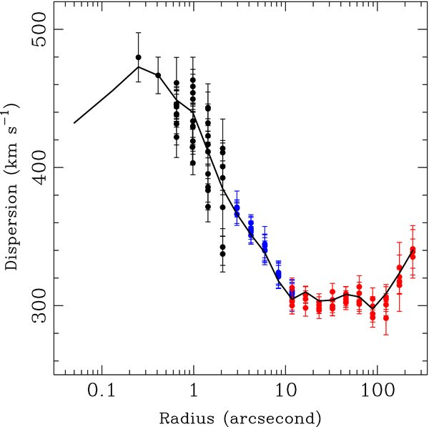
M87 Black Hole Mass
M87 black-hole mass value refined to 6% error by new velocity dispersion measurements in inner arcsecond
Gemini North NIFS + Laser AO
Gebhardt et al. 2011, ApJ, 729, 119

Slide 5
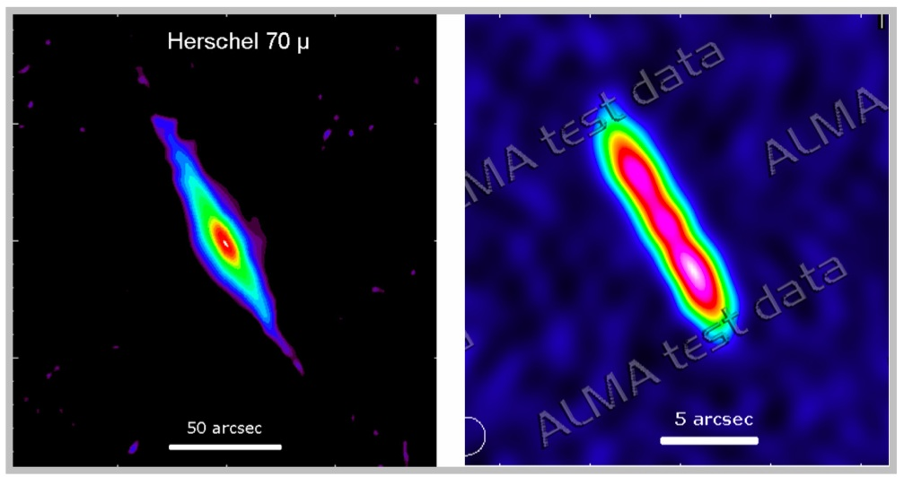
ALMA Science Verification Imaging
Test image of debris disk around Beta Pic at 870 μm
5 arcsec ≈ 100 AU

Slide 6
NSF/Division News
Vern Pankonin named Deputy DD in January
Interviewing for Program Officer to replace him in his previous role during June
Two new rotators started in January/February, both working primarily in grants program
Ed Ajhar, St. Thomas University
Maria Womack, St. Cloud State University
Several rotator positions free up in 2012/2013
Overall NSF budget for FY 2011 passed in April, with decrease of <1% relative to FY 2010 budget

Slide 7
Current Astro2010 Plans
Continuing LSST D&D funding, moving toward PDR and MREFC start (FY14?)
No funding wedge available for mid-scale
Awaiting NSB/NSF response to America Competes Act
CCAT D&D under review
No GSMT commitment in FY12 request
May go ahead with solicitation for selection of candidate for federal investment, depending on FY11 budget level
No current budget envelope for initiating the recommended “small” increases, but protecting AAG & ATI near current levels; Theory/Comp Network discussions with NASA have begun
Pursuing Gemini governance & OIR-system issues

Slide 8
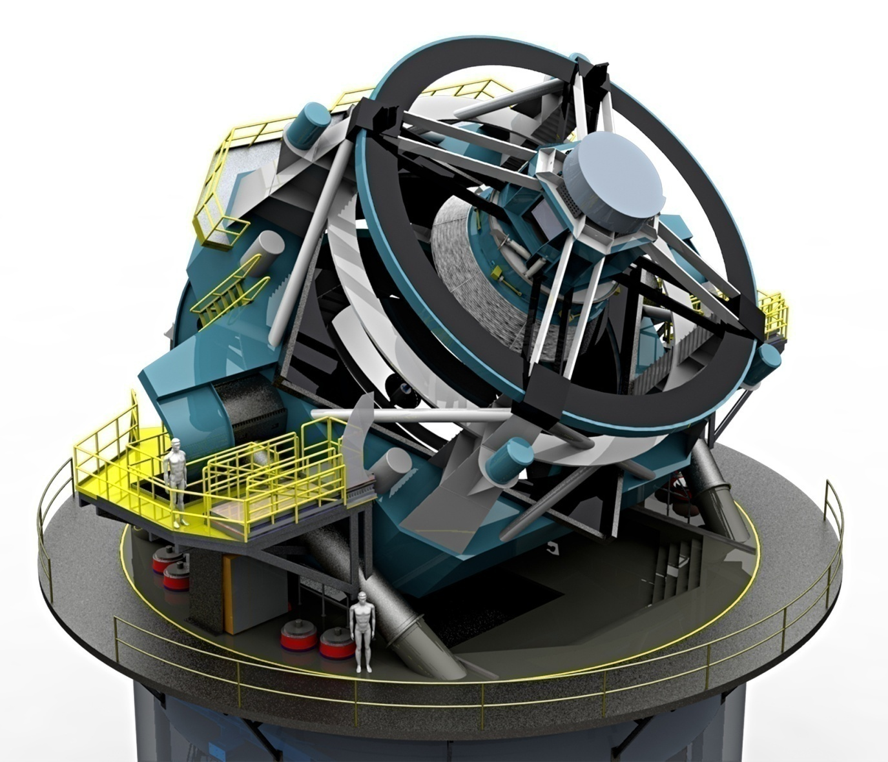
The Large Synoptic Survey Telescope - LSST
8.4 meter primary mirror
3.3 gigapixel digital camera
3.5 deg field of view
30 terabytes of data nightly
Complete coverage of the visible sky twice per week
Nominal 10-yr lifetime
To be on Cerro Pachon, Chile
Current estimate $563M in as spent, then year dollars, assuming a start in FY2014 (NSF $392M, DOE $132M, other $39M)
NSF/DOE Joint Oversight Group meets regularly
Aiming for FY14 MREFC start
NSF Director recently approved holding of Preliminary Design Review; aiming for late August

Slide 9
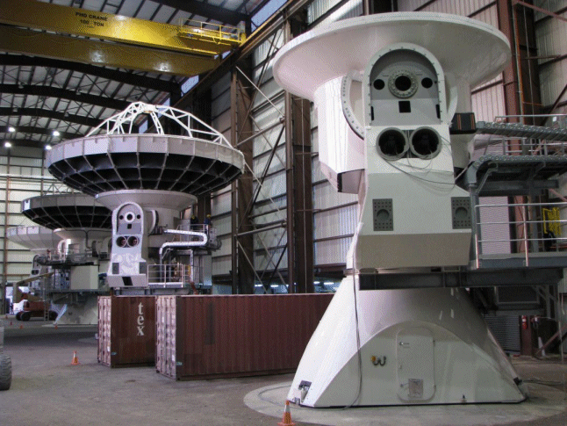
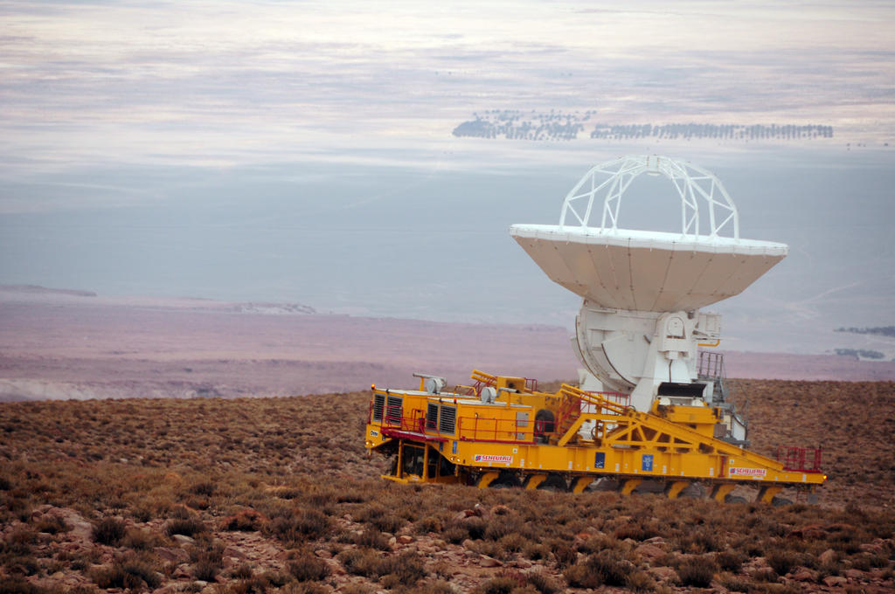
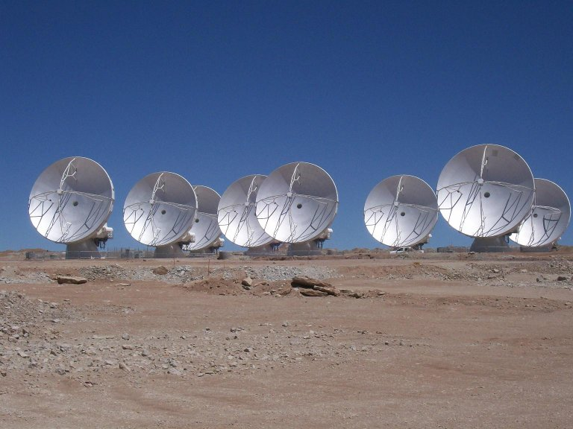
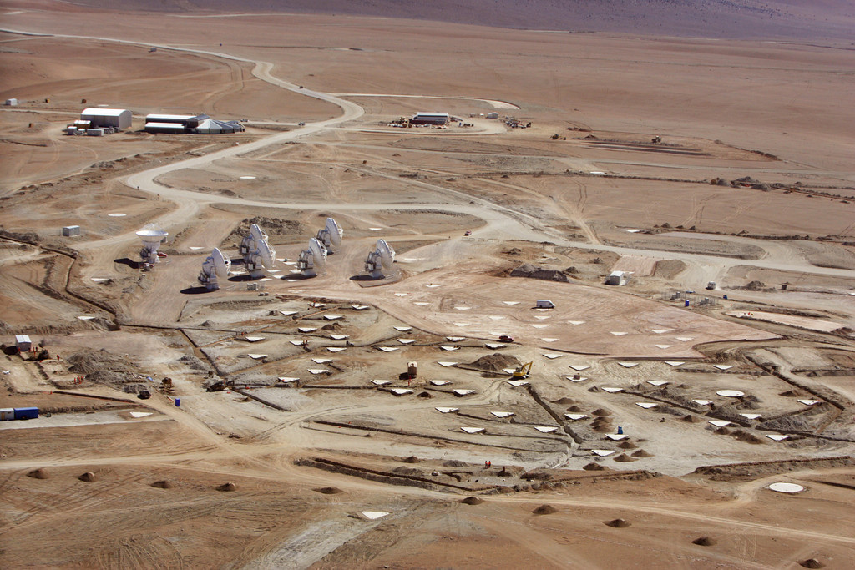
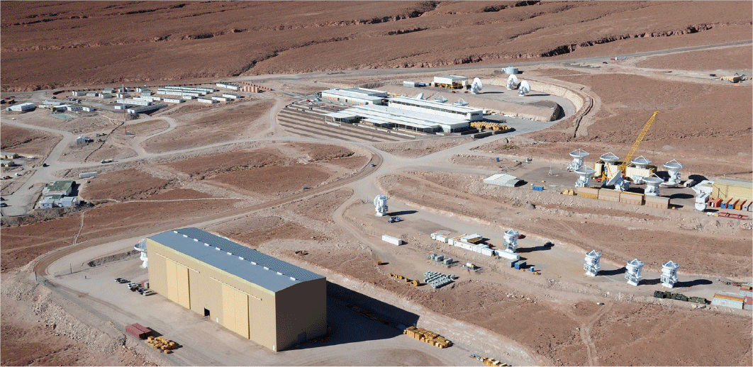
ALMA Status
41 antennas in Chile
Early science in late 2011; 100s of Letters of Intent
Proposal workshops at this meeting

Slide 10
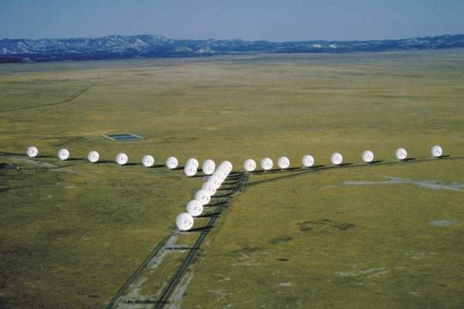
Expanded Very Large Array
VLA upgraded through the Expanded Very Large Array (EVLA) project
$94 M funded by NSF, Canada, and Mexico
NSF funding 2001 through 2011
Scheduled for completion in 2012, on time and on budget
Same number of antennas.
All-new telescope electronics, yielding greatly increased sensitivity and spectral flexibility
Shared-risk science now under way, with ApJL special issue in preparation
Session 216, 3:40 p.m. today

Slide 11
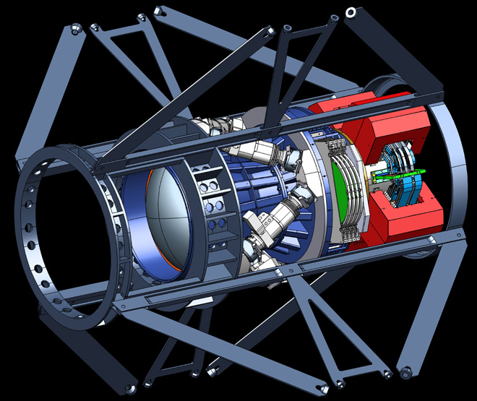
NSF/NOAO + DOE: Dark Energy Camera and Survey on CTIO/Blanco 4-meter
Dark Energy Camera (DECam)
62 2Kx4K LBL red-sensitive CCDs, 3 deg² FOV
Blanco upgrades (new TCS, clean room, control room)
Installing CCDs in camera now @FNAL
Installation on Blanco Nov/Dec 2011
Commissioning Jan-Apr 2012
Community science data reduction pipeline included
Dark Energy Survey (DES)
Survey begins September 2012
Will pursue four approaches to the study of Dark Energy:
(1) Cluster Counts; (2) Weak Lensing; (3) BAO; (4) SNe
Two multiband surveys:
(1) 5,000 deg² in g, r, i, Z, Y to i ~24; (2) 9 deg² deep SNe
105 nights per year dedicated to DES
Camera available for community use when not in survey mode
Community Workshop: “Seeing the Big Picture” Tucson Aug 18-19, 2011
Come, learn, and help define camera operations and reductions for YOUR SCIENCE
See http://www.noao.edu/meetings/decam/

Slide 12
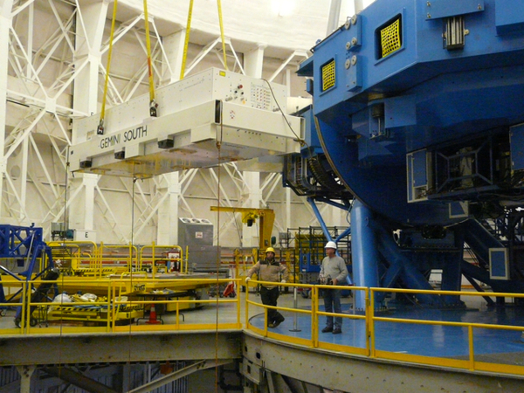
Gemini MCAO Constellation
50-watt laser (above) is projected as a 5-spot constellation covering 1 sq. arcmin by GeMS to illuminate the sodium layer ~90 km above Cerro Pachon, Jan. 22, 2011.
Also, Flamingos-2, GPI coming along for Gemini-South.

Slide 13
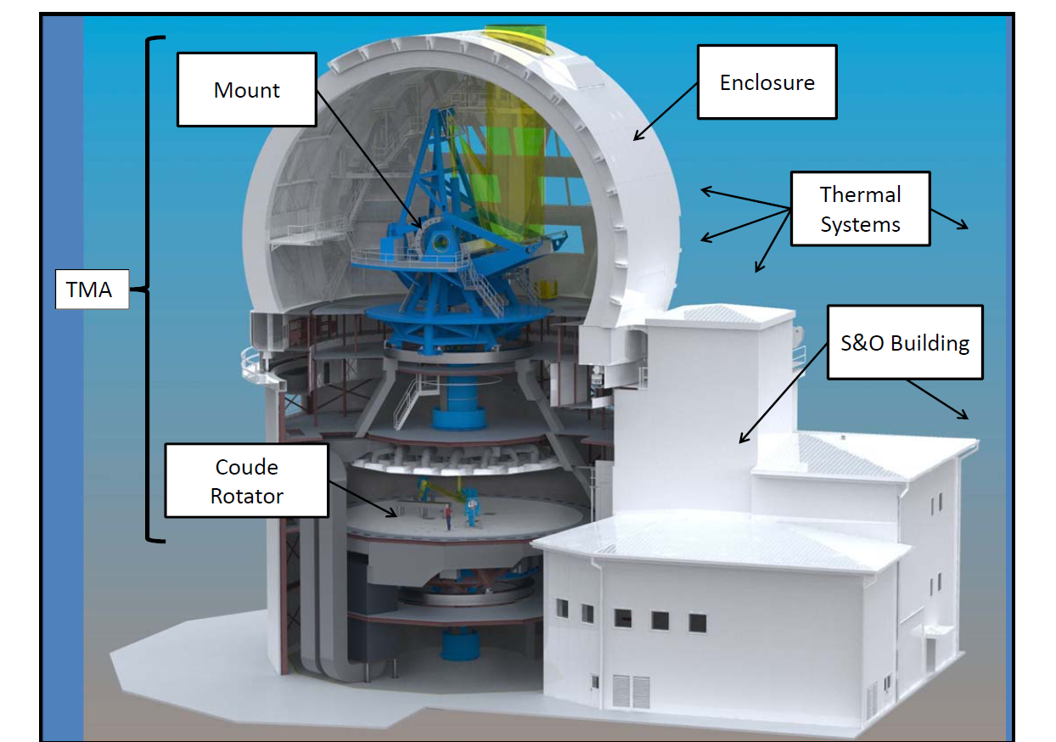
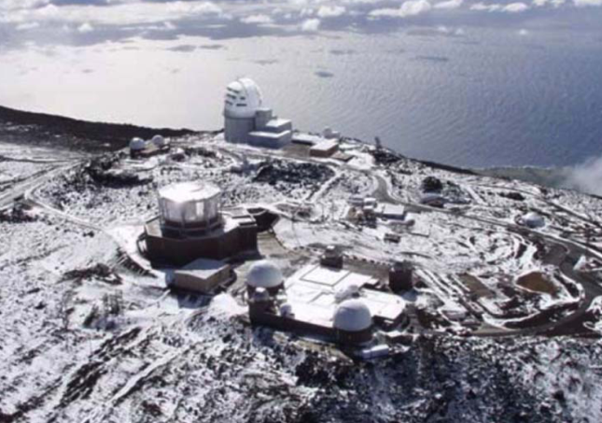
Advanced Technology Solar Telescope
Contracts for nearly all major sub-systems have been let.
Construction permit granted in December 2010. Currently being challenged by a Native Hawaiian organization. Expect resolution in the late summer.
Assuming site access in the early fall, full scientific operations will start in 2018.

Slide 14
Facility Management News
Gemini
Doug Simons’ term as Director ended; Fred Chaffee is Interim Director. Search beginning for next Director.
Proposal for new Cooperative Agreement beginning in mid-2012 has been received and reviewed.
NAIC (Arecibo)
Competition for 2012-2016 management concluded.
Consortium led by SRI selected as new managing organization.
NOAO: Search for KPNO Director nearing conclusion.
NRAO: Search for EVLA/VLBA Director nearing conclusion.
NSO: Competition ongoing for new HQ location.

Slide 15
Grants News-1
In FY11, AST meeting NSF goal of acting on 70% of proposals within six months of proposal deadline.
AAG Program
Number of proposals increased 18-20% in FY 2011 (from ~600 to ~710, counting collaborative proposals), larger than funding increase recommended by Astro2010 for entire decade.
Even with funding held constant (see later budget slides), success rate would go from ~21% to ≤ 17%.
Uniformity of compliance review is improving.
All AAG (and other) proposals in future MUST include Data Management Plan (up to two pages); see AST web site.

Slide 16
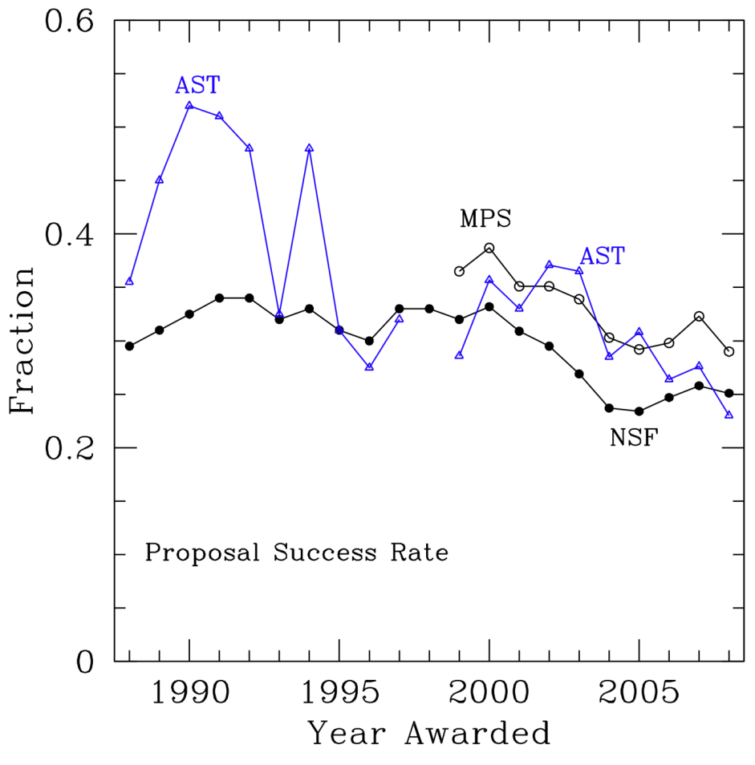
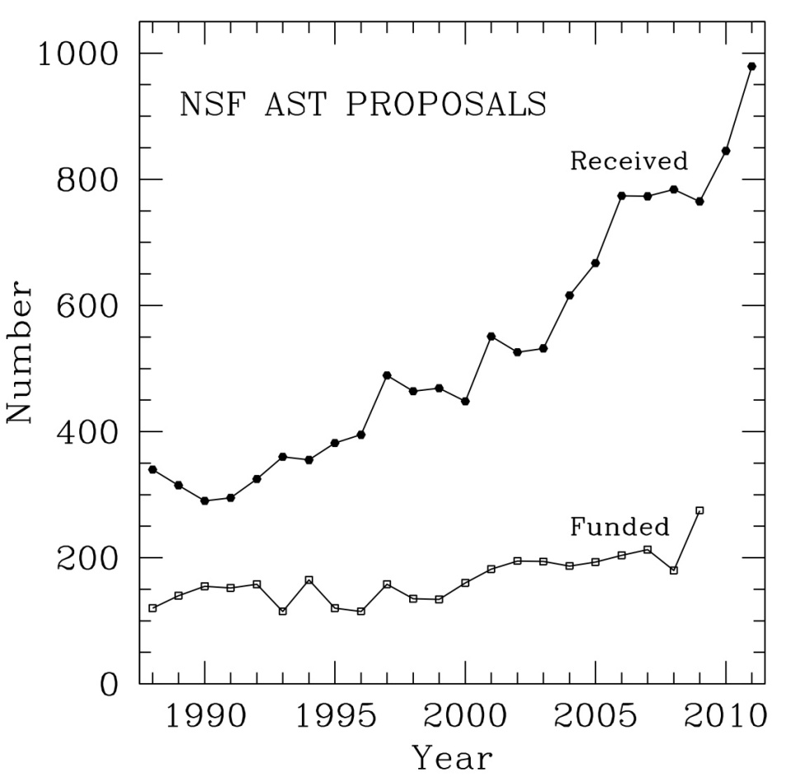
Grants News-2
Proposal success rate is on a long-term downward trend through all of NSF

Slide 17
Grants News-3
University Radio Observatories proposal deadline this week, for FY 2012-2014.
Nine AAPF awards made in FY 2011.
Expect to make six CAREER awards in FY 2011.
Attempting to hold ATI program budget roughly constant in FY 2011; depends on final AST budget.
Six REU site awards made.
MPS Directorate is assessing programs for Broadening Participation; will determine future of PAARE after this assessment.

Slide 18
Grants News-4
New interdisciplinary programs in President’s FY 2012 budget request
Cyberinfrastructure Framework for 21st Century Science and Engineering (CIF21)--$117M total, $4M AST
Data-Enabled Science
Community Research Networks
New Computational Infrastructure
Access and Connections to Cyberinfrastructure Facilities
Enhancing Access to the Radio Spectrum (EARS)--$15M total, $3M AST
Related to National Broadband Plan and Wireless Innovation Fund

Slide 19
Realities of FY 2011 and 2012 Budgets
 | NSF R&RA | %/FY10 | AST | %/FY10
FY10 Omnibus | $5.62B | 0.0% | $245.7M | 0.0%
FY11 Request | $6.02B | (+8.0%) | $251.8M | (+2.5%)
FY11 Approp. | $5.56B | -0.9% | ??? | -xx%
FY12 Request | $6.25B | (+12.4%) | $249.1M | (+1.4%)
FY12 Approp. | ??? | ??? | ??? | ???
MREFC line was cut from $165M in FY11 request to $117M in appropriation (=FY10). This will stretch out projects currently in the MREFC plan, if similar cuts continue in the future.

Slide 20
Sample Budget Scenarios for Astro2010
1: FY11=0.95*FY10, then 2.5%/yr (or flat?)
2: FY11&12=request, then flat
3: FY11&12=request, then 2.5%/yr
4: FY11&12=request, then 4.5%/yr
5: FY11&12=request, then 6.5%/yr

Slide 21
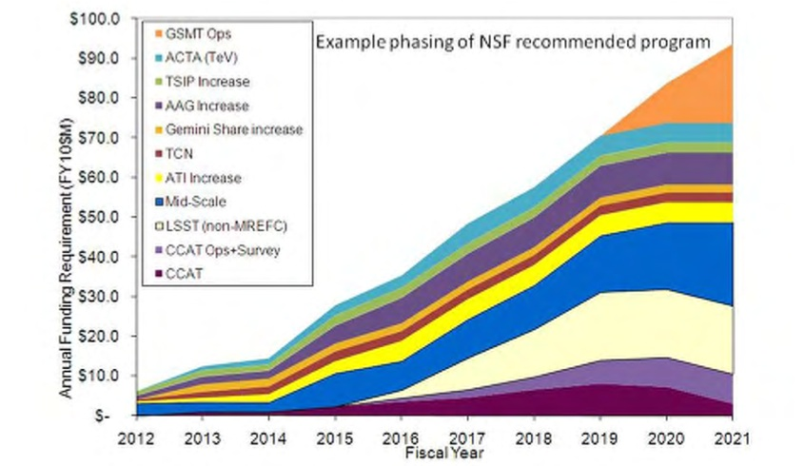
Astro2010 Ramp + Budget Scenarios
5
4
3

Slide 22
Facilities Funding (inspired by M. Longair)
In FY11 dollars, the U.S. capital cost of operating national facilities is ~$1.2 billion.
CTIO, EVLA, GBT, Gemini, KPNO, NAIC, VLBA
Additional U.S. capital cost spent or committed for ALMA and ATST is ~$0.8 billion.
Total of $2.0 billion capital cost
Using 10% rule, U.S. operating cost would be $200 million (and this doesn’t include LSST or GSMT).
But the entire AST division budget for FY10 was $245 million.
If budgets do not increase substantially, AST would become much more facility-heavy by end of decade.

Slide 23
AST Portfolio Review
Likelihood that AST budget will not follow a “doubling” trajectory for the next decade leads to the necessity of carrying out a portfolio review of AST programs
Internal working group of six program officers developed a draft charge and management plan, which was presented to (and approved by) MPS Advisory Committee in April.
Portfolio review coordination group then formed within AST to finalize the plans and oversee the execution of the portfolio review.
More details presented by Tom Statler in following slides.

Slide 24
AST Portfolio Review
AAS Meeting – NSF Town Hall
May 24, 2011
Tom Statler
Program Director, AST

Slide 25
Why Do It and What Is It?
NWNH advised: “If …budget is truly flat…there is no possibility of implementing …the recommended program…without…enacting the recommendations of the first 2006 senior review and/or …a second more drastic…review before mid-decade.” (p. 240)
Not a repeat of Senior Review, which was confined to facilities.
Examine balance across entire portfolio of activities AST supports.
Maximize progress on central science questions (Ch. 2 of NWNH), balancing recommendations for new facilities, instrumentation and program enhancements with capabilities enabled by existing facilities and programs.

Slide 26
The time for difficult decisions is here.
AST is committed to conducting the decision-making process in a way that is as fair as possible.

Slide 27
Structure of the Review
Committee to be appointed in June-July.
Call for nominations from community to go out soon.
Goal is for broad diversity with regard to wavelength, observation/theory/computation/instrumentation, facility users, institution type/size, career stage, gender, geography.
Conflicts of interest will be managed carefully.
Committee work to begin in August.
Draft report to MPSAC by 31 March 2012.
Why so soon? Latest possible for informing budget process for FY2014.

Slide 28
Committee Charge
2-stage process:
Recommend critical capabilities needed from 2015 to 2025 enabling progress on Astro 2010 Science Frontier questions. “Capabilities” include observation, theory, computation, laboratory, grant support, workforce, education.
Recommend balance of investments in new and in existing-but-evolved facilities, programs, & activities delivering needed capabilities within budgetary scenarios to be provided. Recommendations may include closures, divestments, terminations.

Slide 29
Review Philosophy
Note that review is explicitly forward-looking
Key question re: existing facilities is
Can the facility be evolved so as to provide a critical future capability?
--- not ---
Has the facility earned the right to survive by virtue of past performance?
Avoid overburdening facilities with demand for statistics or overburdening committee with need to invent metrics of productivity.

Slide 30
Committee Charge (cont’d)
No revisiting/rehashing Astro2010 process or recommendations.
Consider effects on the future landscape of U.S. ground-based astronomy and theoretical and laboratory astrophysics.
Portfolio should support/develop workforce with abilities & diversity to exploit recommended research & education investments.
Prioritize in sufficient detail to allow for adjustments in response to variations in Federal and non-Federal funding.
Recommendations should lead to a vigorous and sustainable future.

Slide 31
Community Input
Expect to go live by mid-June.
Information from AST to be disseminated via
Website, TBA
AAS “exploder” Emails – watch your inbox!
Possible Webex briefings or podcasts
Input to AST & committee via Email address TBA.
Nominations for chair, committee membership
Suggestions on priorities, comments on process
Progress reports in AAS Newsletter & mailings, AAS Jan 2012 meeting.

Slide 32
Whom to Nominate?
People who can facilitate the 2-stage process of the charge.
People free from serious conflicts of interest.
People with a broad vision of the field.
People with a broad range of backgrounds, demographics, experience, employment situations.
People who will listen to and respect arguments disagreeing with their own.
People with the capacity to recommend a course of action that could adversely impact their own science, for the long-term benefit of the entire community.

Slide 33
Thank you…
…in advance for your carefully considered participation in this challenging process.

