Slide 1
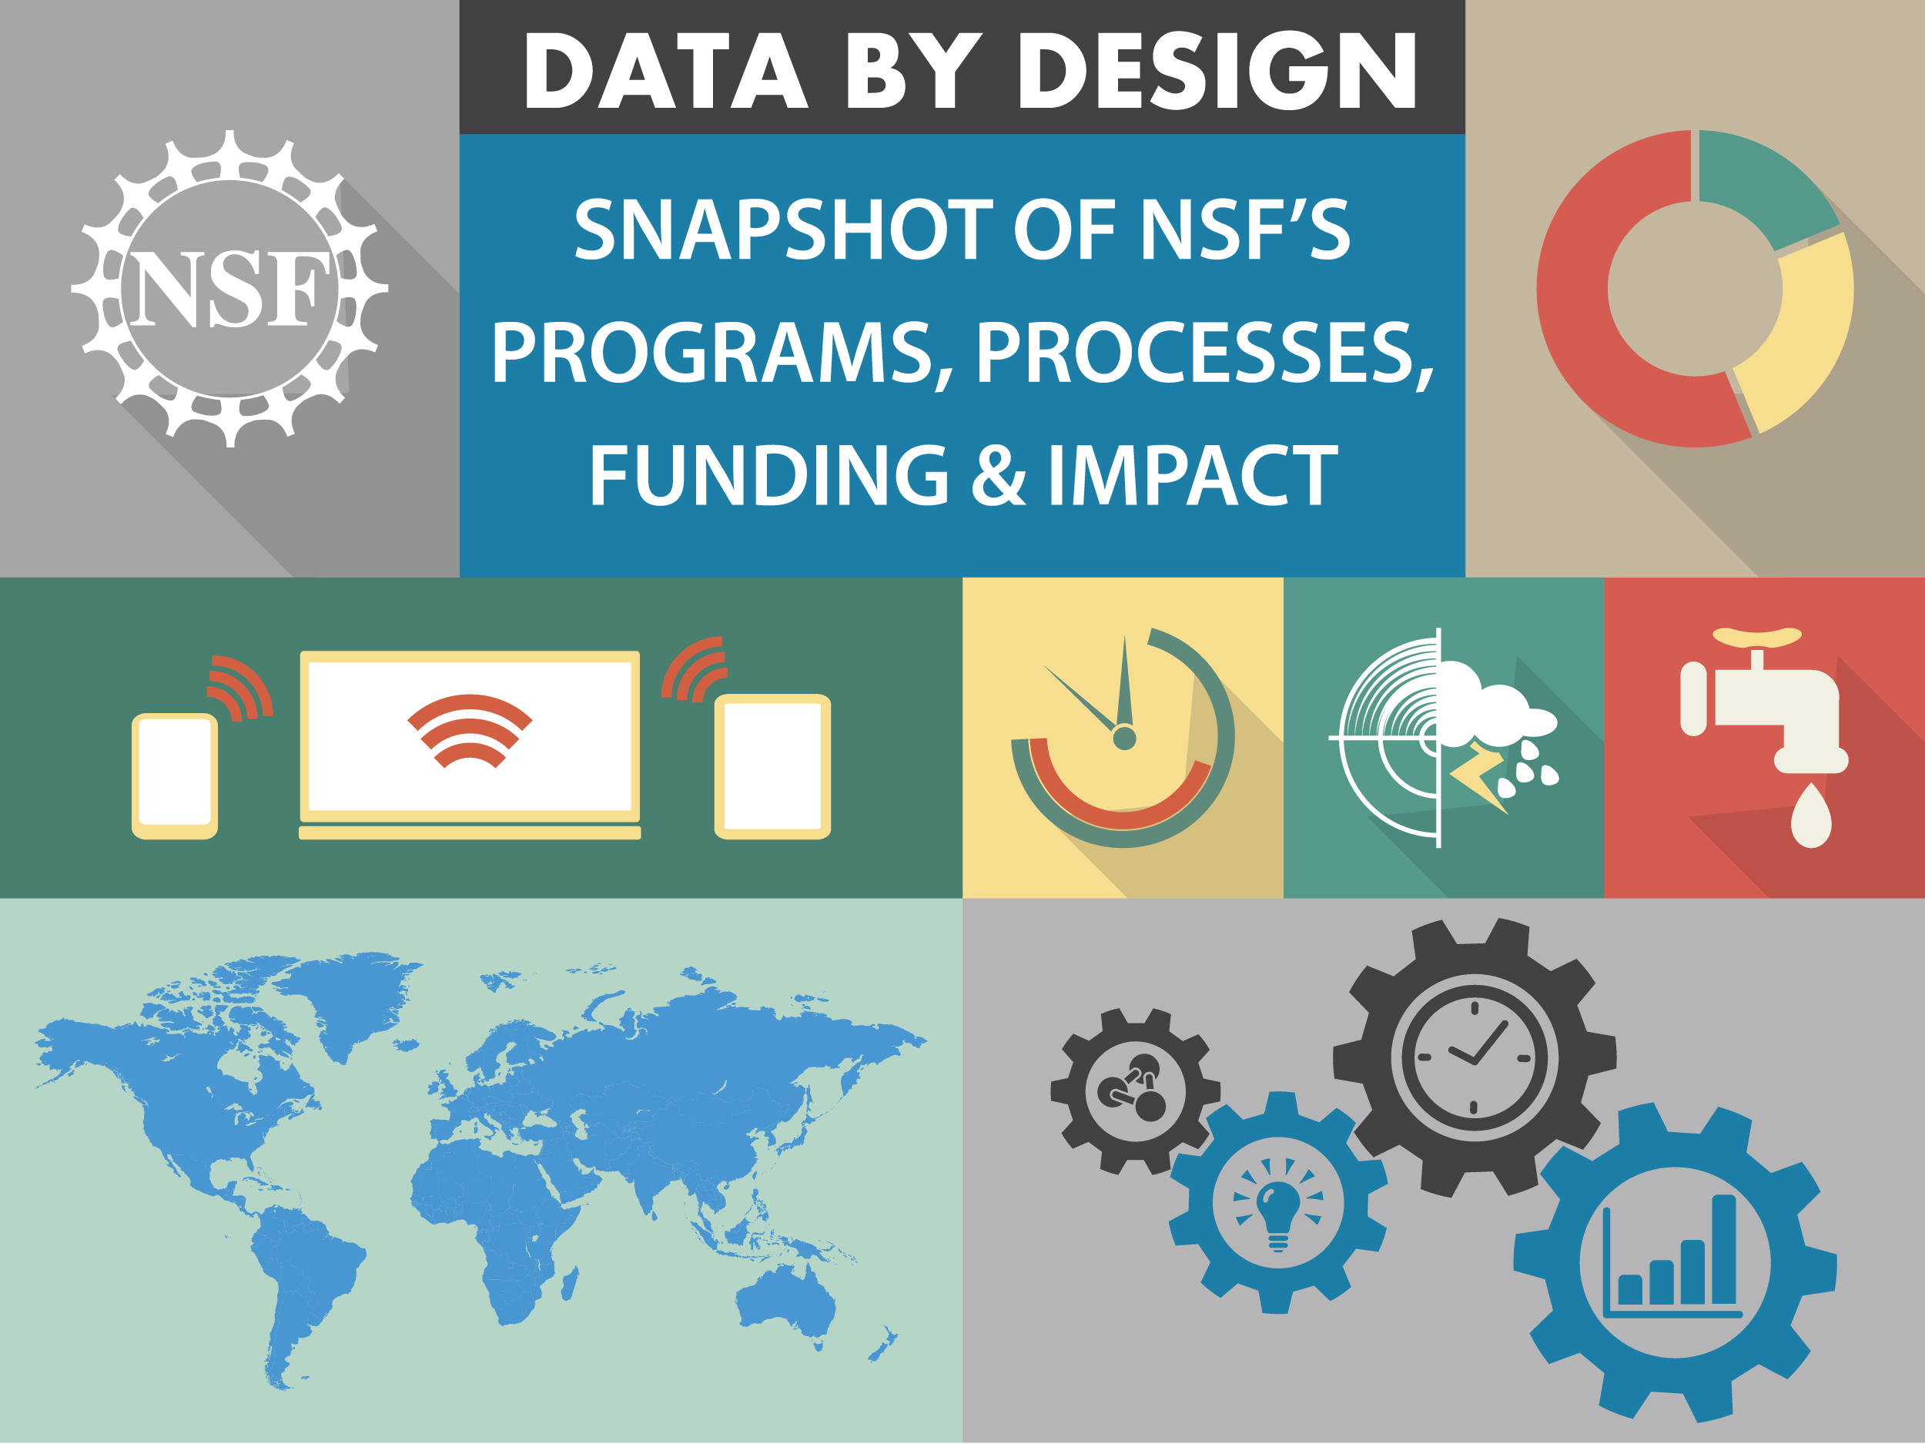

Slide 2
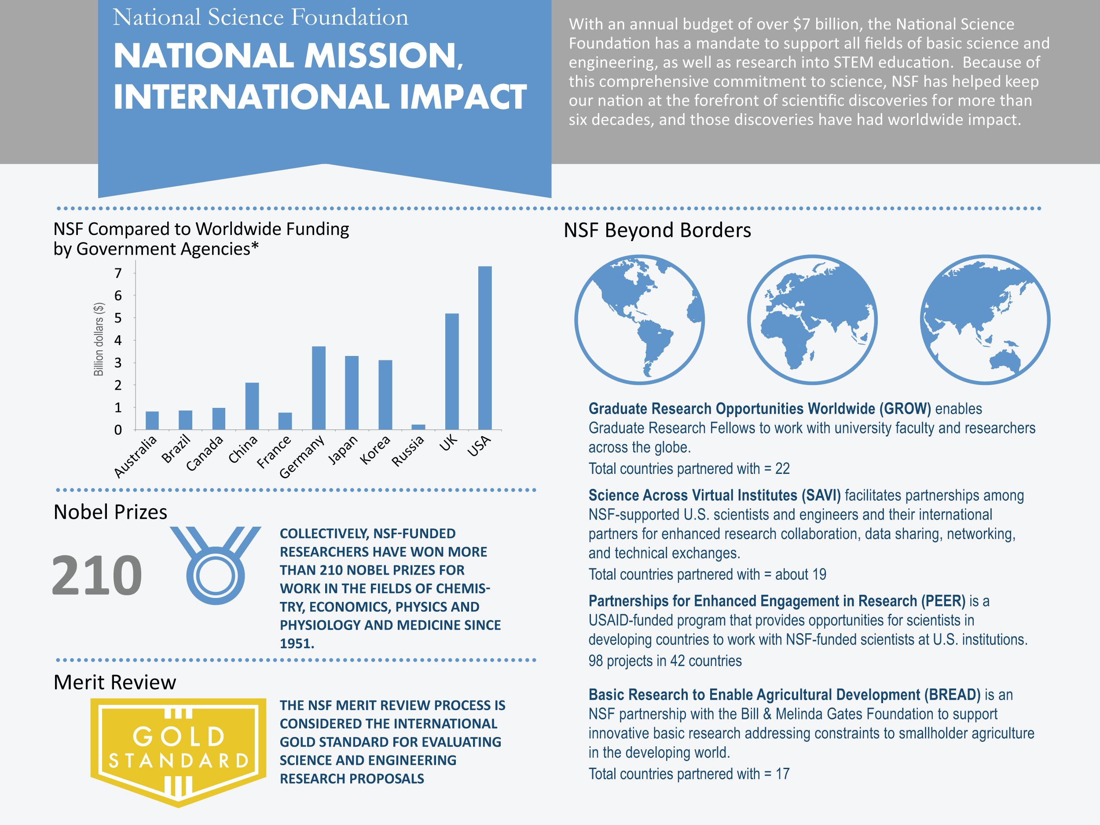

Data Current as of 2014
* Source: Approximations based on FY2015, or most recent fiscal year, budget reported by each research agency

Slide 3
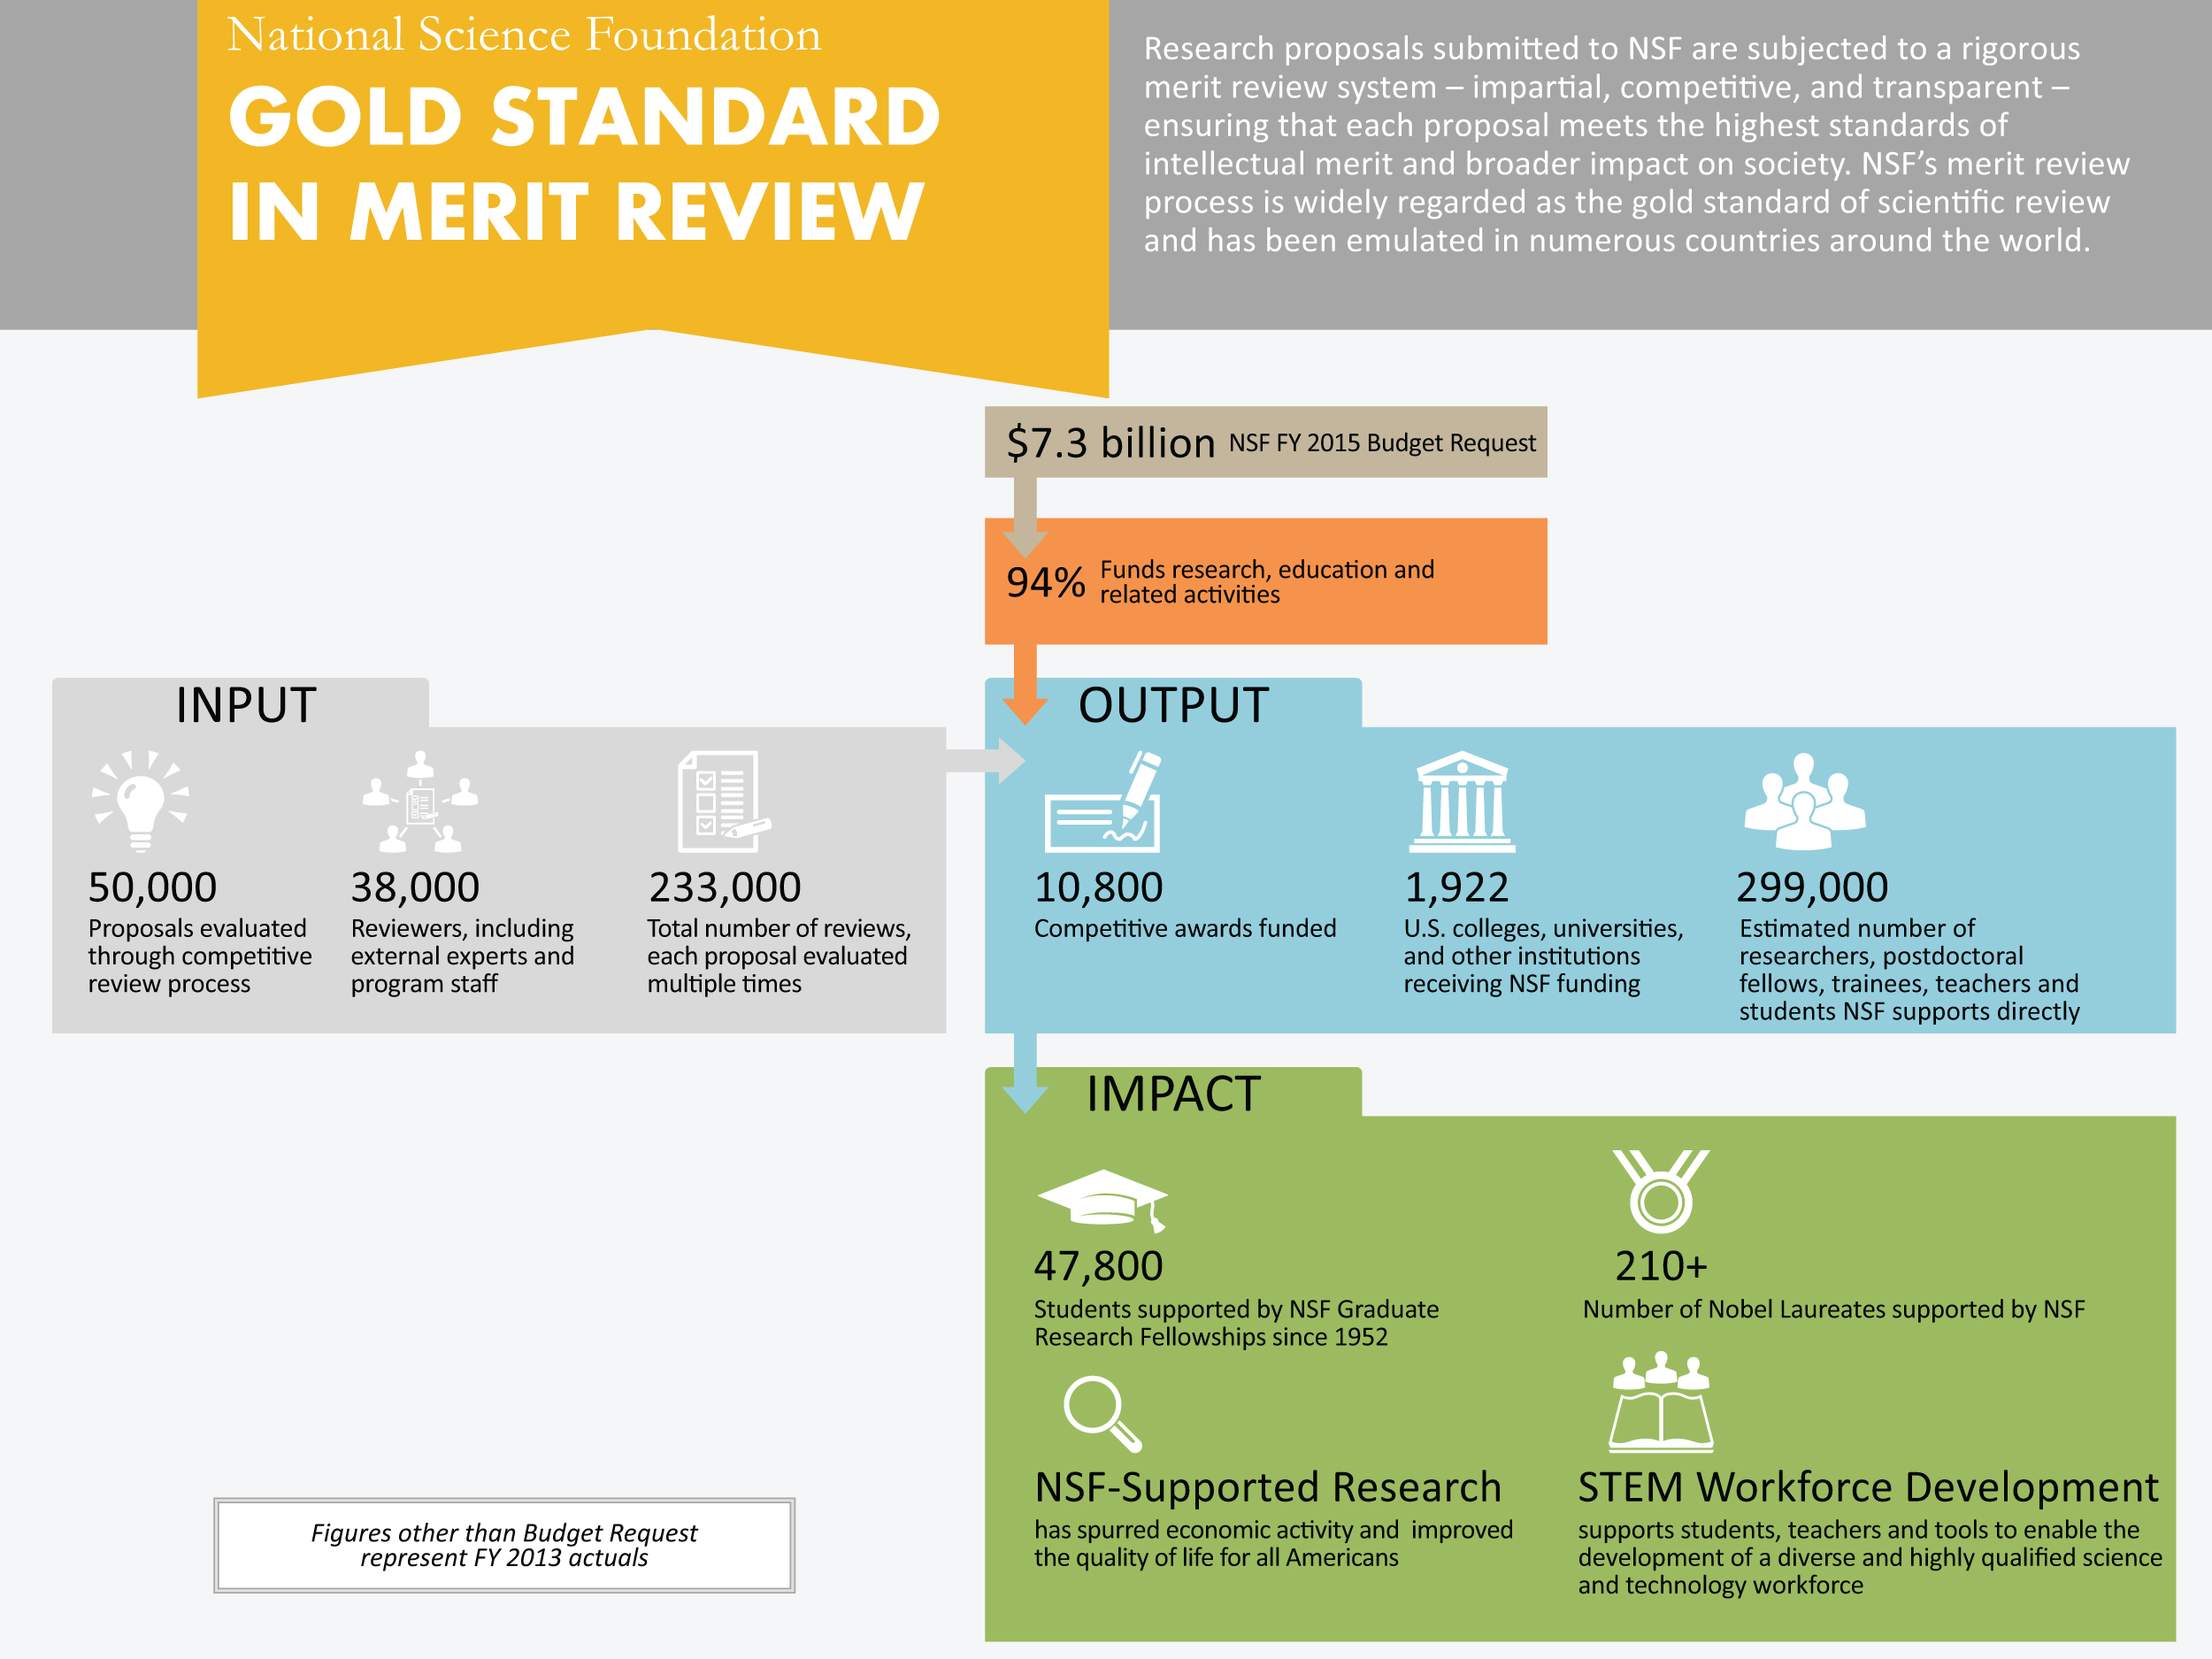
Data Current as of 2014

Slide 4

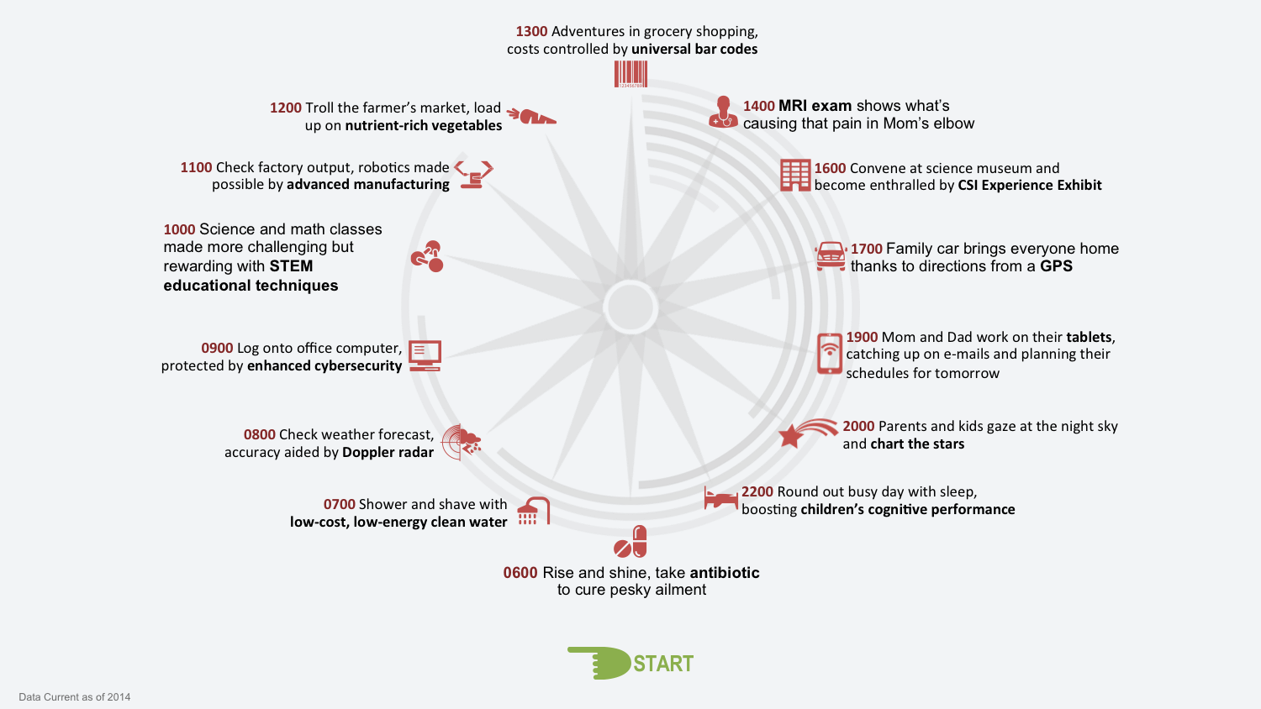


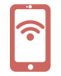

1300 Adventures in grocery shopping,
costs controlled by universal bar codes
1200 Troll the farmer’s market, load
up on nutrient-rich vegetables
1400 MRI exam shows what’s
causing that pain in Mom’s elbow
1100 Check factory output, robotics made
possible by advanced manufacturing
1600 Convene at science museum and
become enthralled by CSI Experience Exhibit
1000 Science and math classes made more challenging but rewarding with STEM educational techniques
1700 Family car brings everyone home
thanks to directions from a GPS
0900 Log onto office computer,
protected by enhanced cybersecurity
1900 Mom and Dad work on their tablets,
catching up on e-mails and planning their
schedules for tomorrow
0800 Check weather forecast,
accuracy aided by Doppler radar
2000 Parents and kids gaze at the night sky
and chart the stars
0700 Shower and shave with
low-cost, low-energy clean water
2200 Round out busy day with sleep,
boosting children’s cognitive performance
0600 Rise and shine, take antibiotic
to cure pesky ailment
Data Current as of 2014

Slide 5
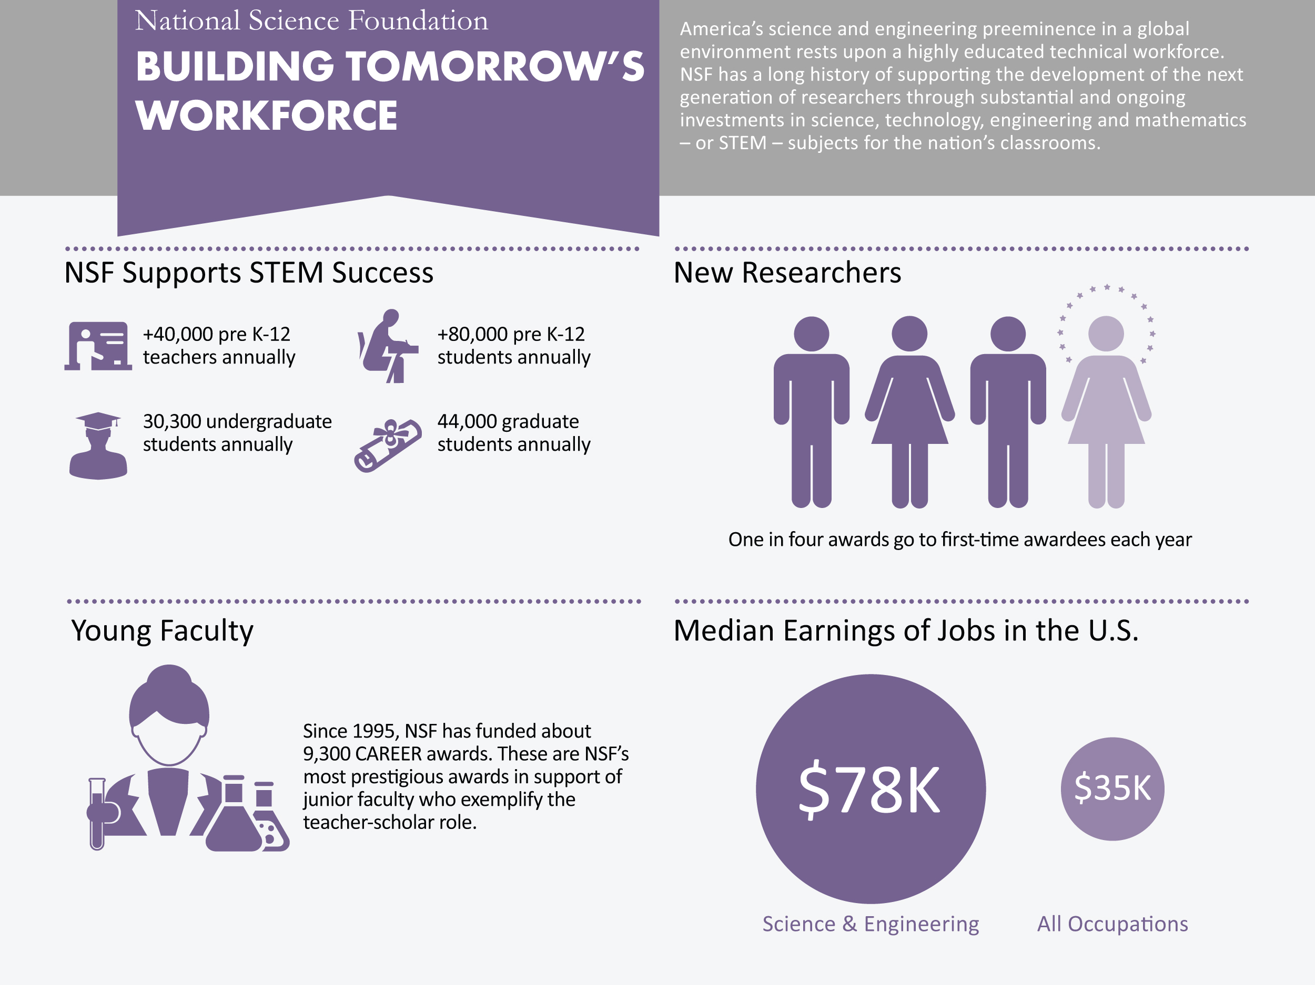
*
Data Current as of 2014
*Source: Science and Engineering Indicators 2014

Slide 6
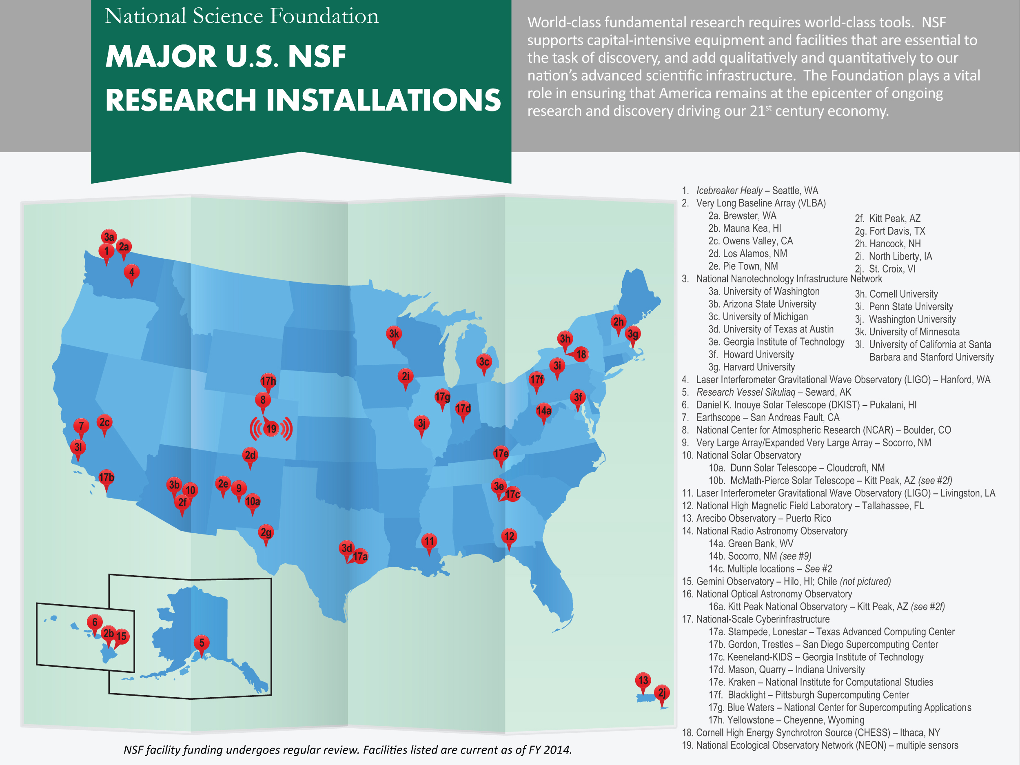
Data Current as of 2014

Slide 7
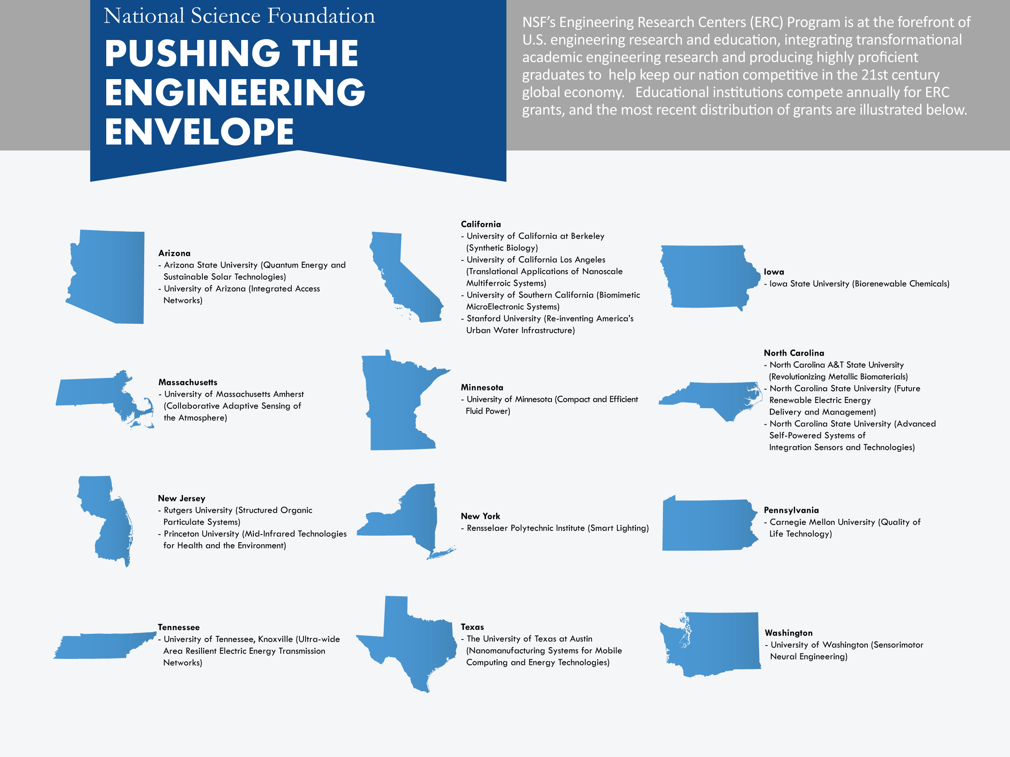
Data Current as of 2014
Source: http://erc-assoc.org/content/all-current-and-graduated-research-centers

Slide 8
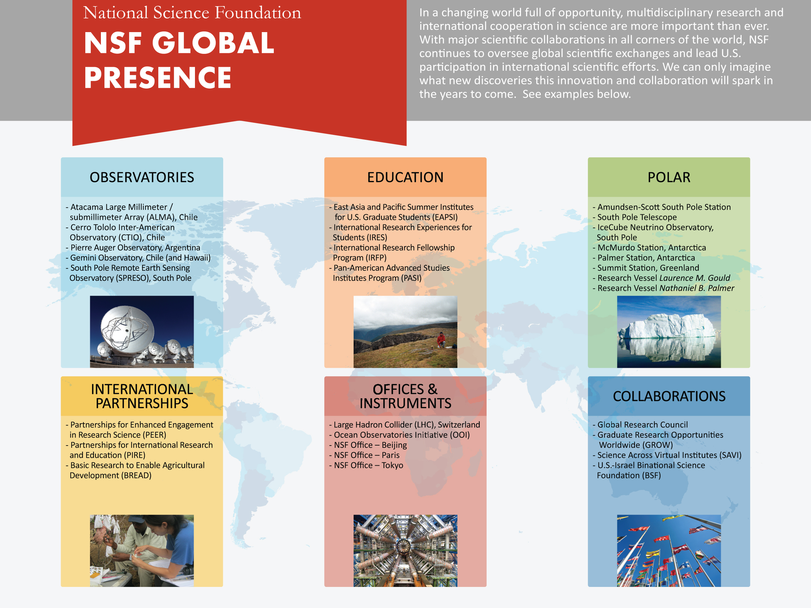
Data Current as of 2014

Slide 9
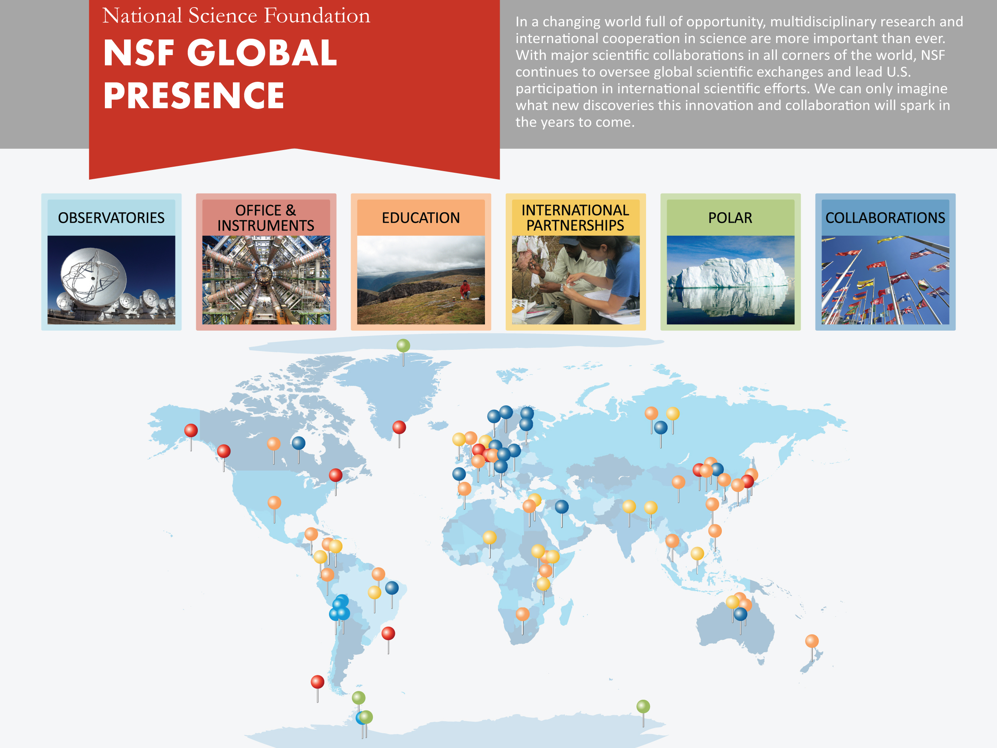
Data Current as of 2014

Slide 10
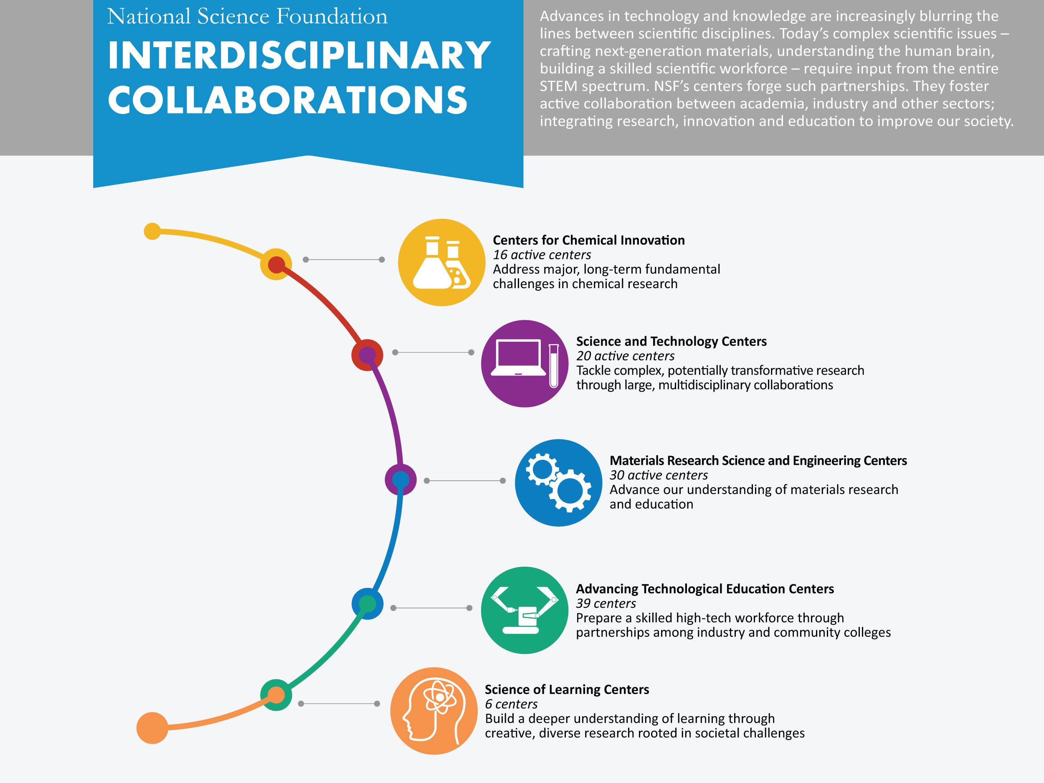
Data Current as of 2014

Slide 11
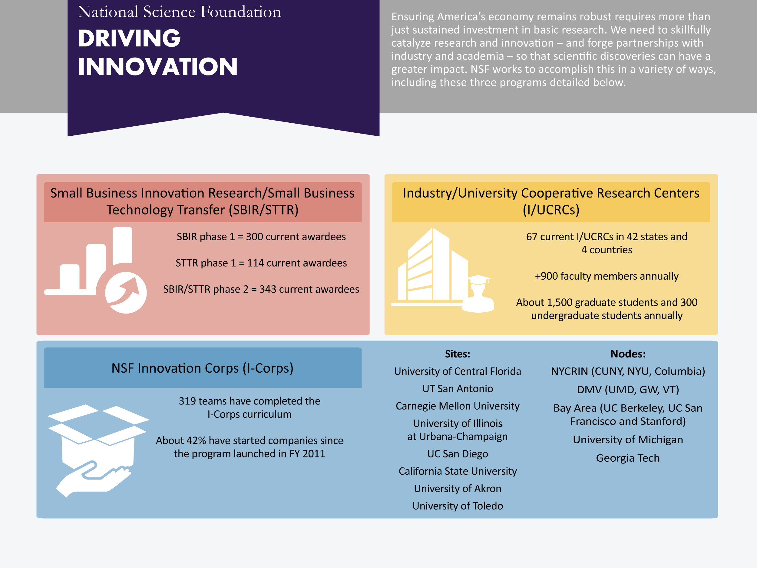
Data Current as of 2014

Slide 12
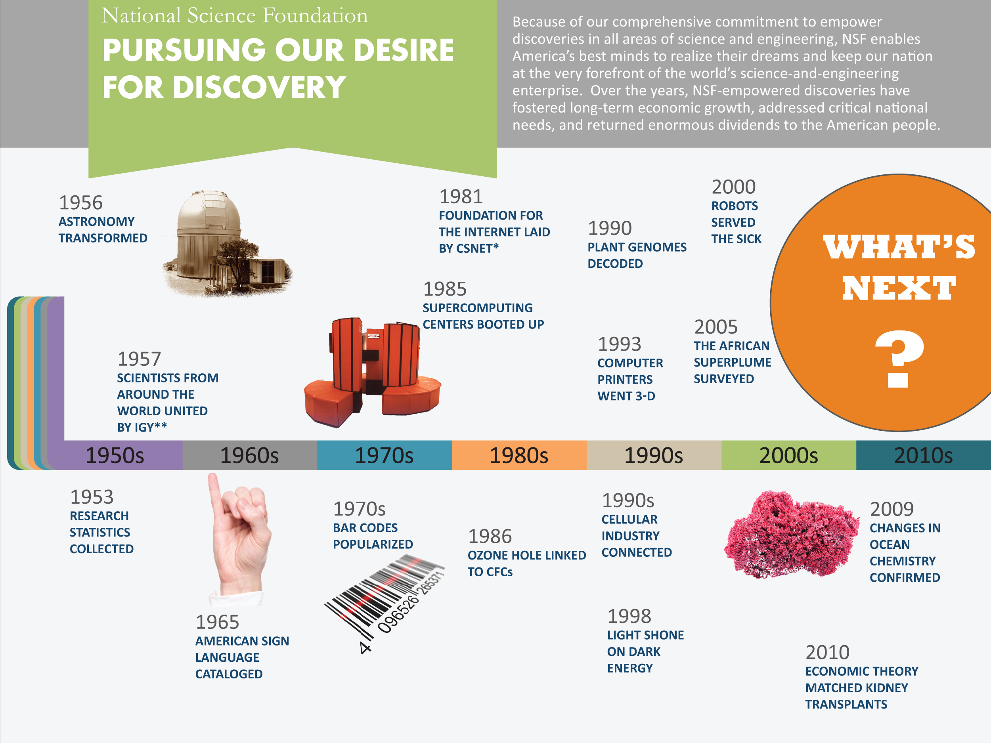
Data Current as of 2014
* Computer Science Network; ** International Geophysical Year

Slide 13
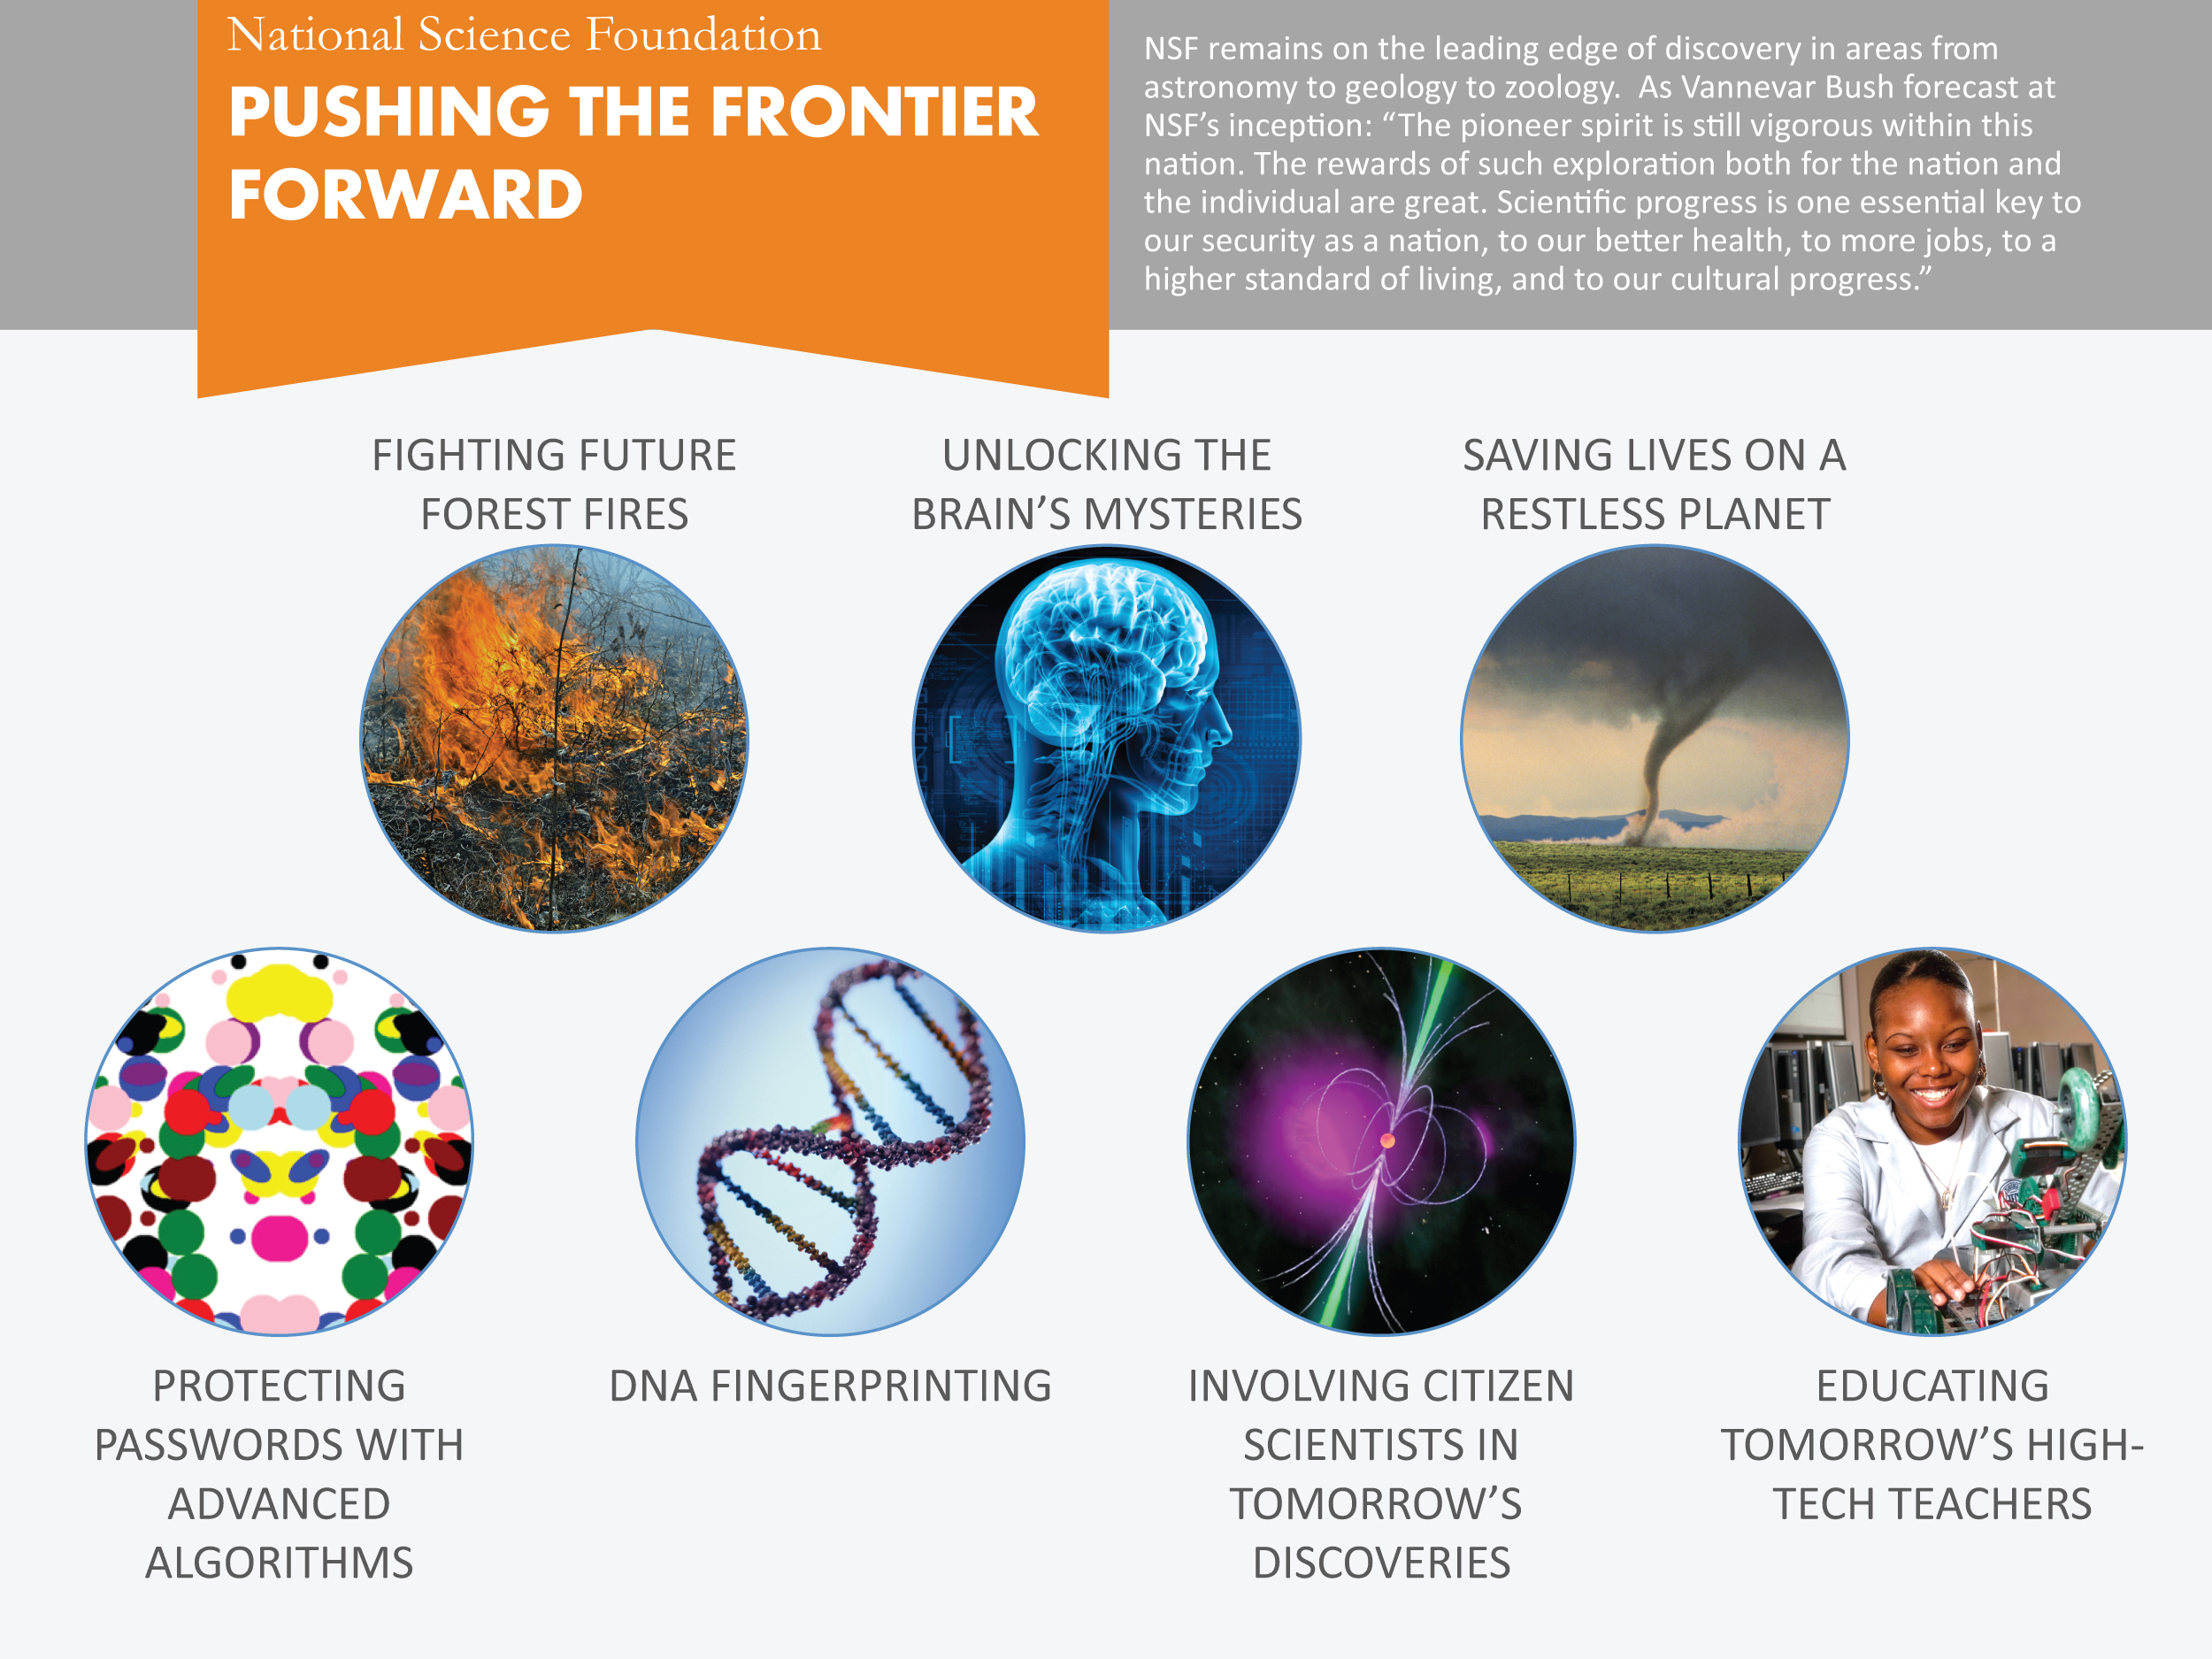
Data Current as of 2014

Slide 14


